Slide 1


Aligning Brand Purpose to Public Mood

Slide 2
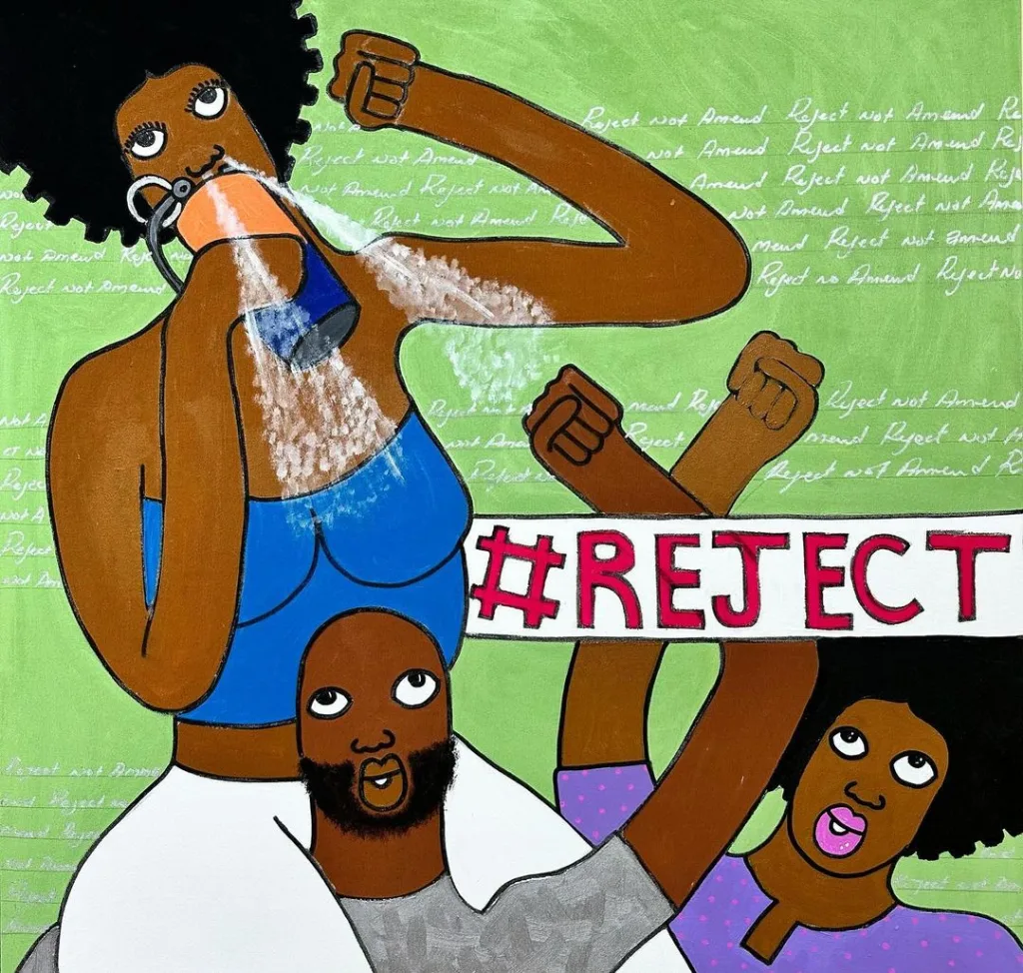
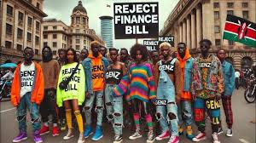



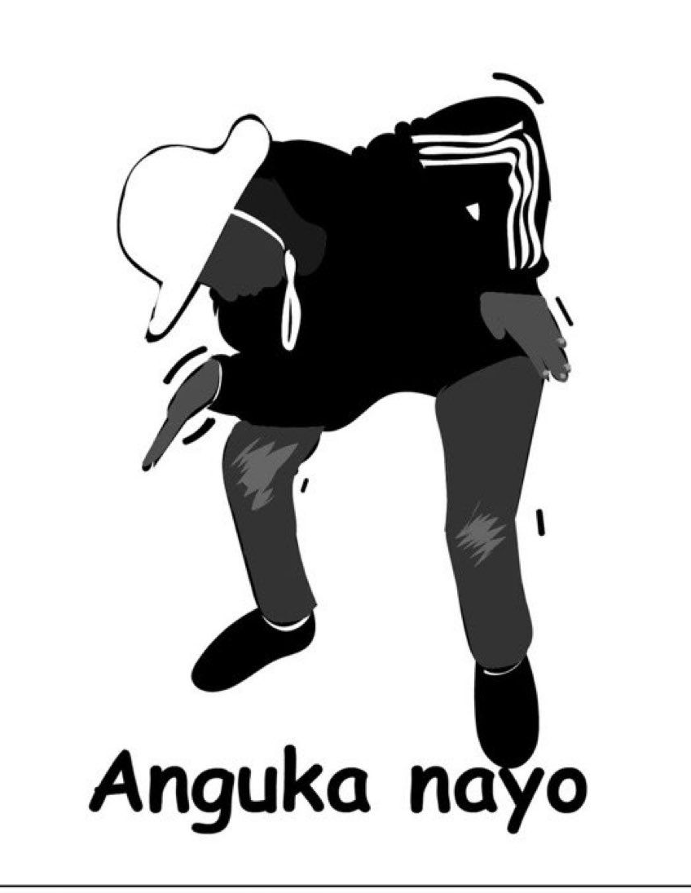
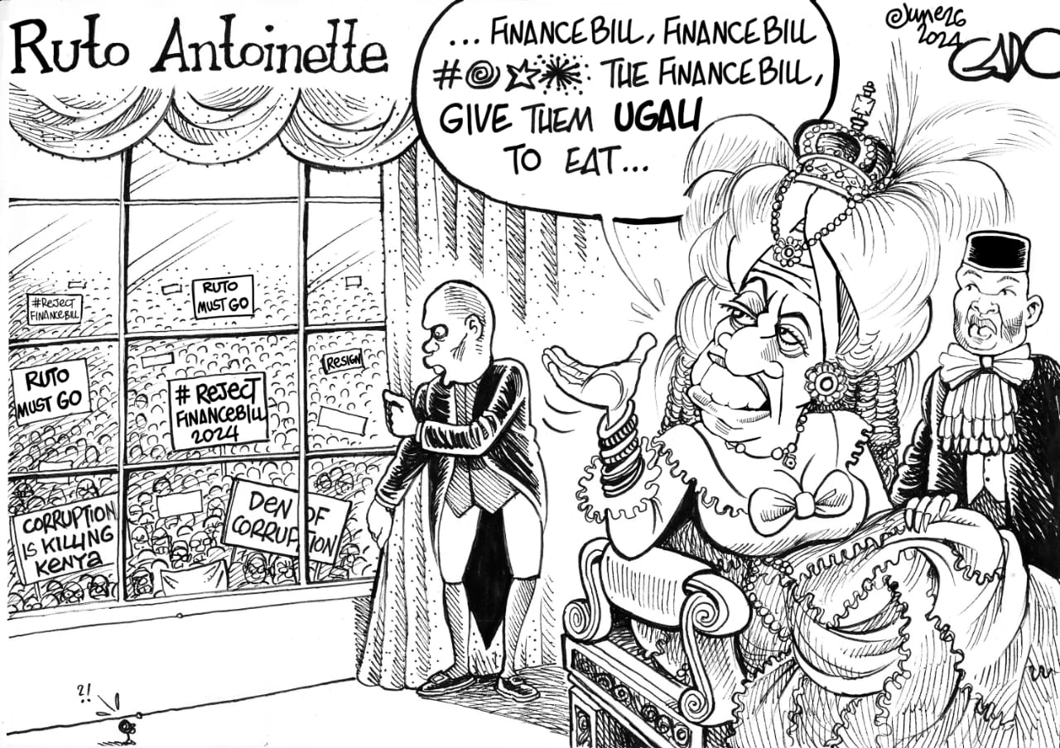
Art is a reflection on society and the times

Slide 3
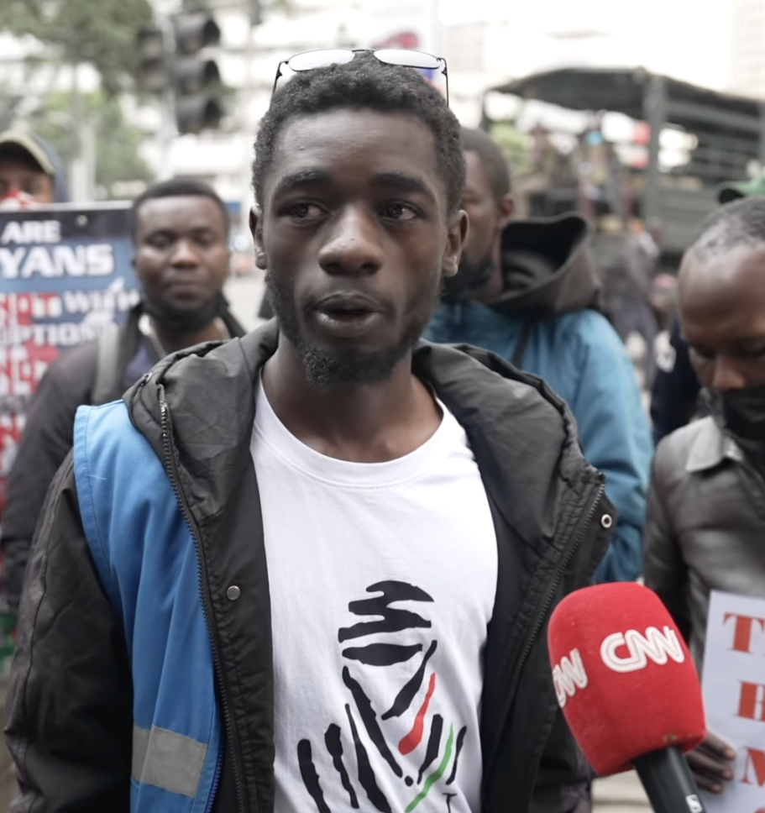
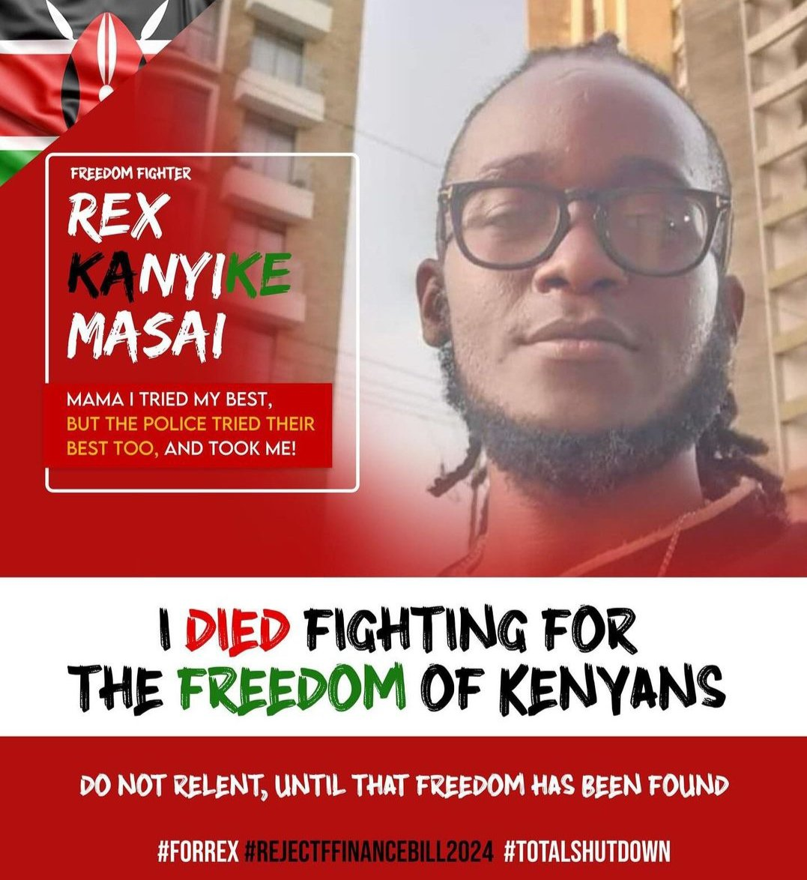
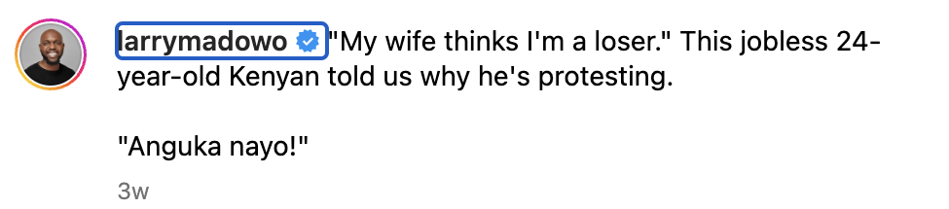
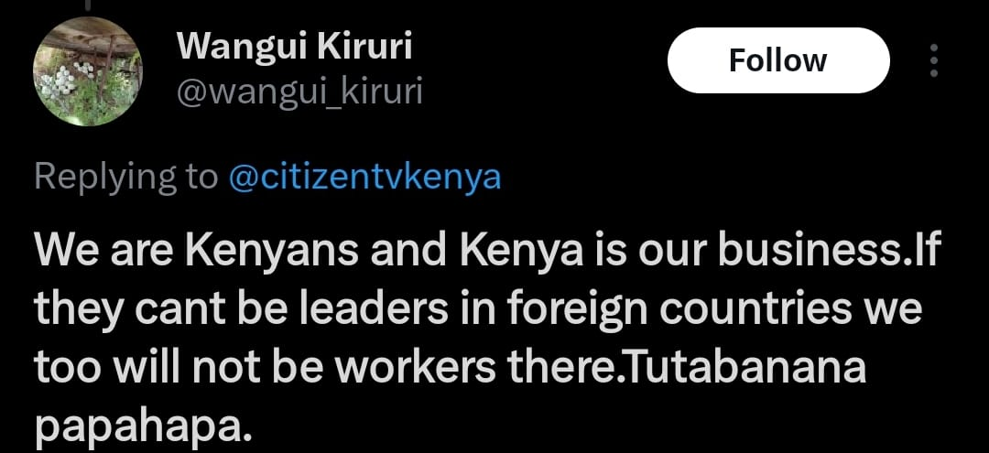
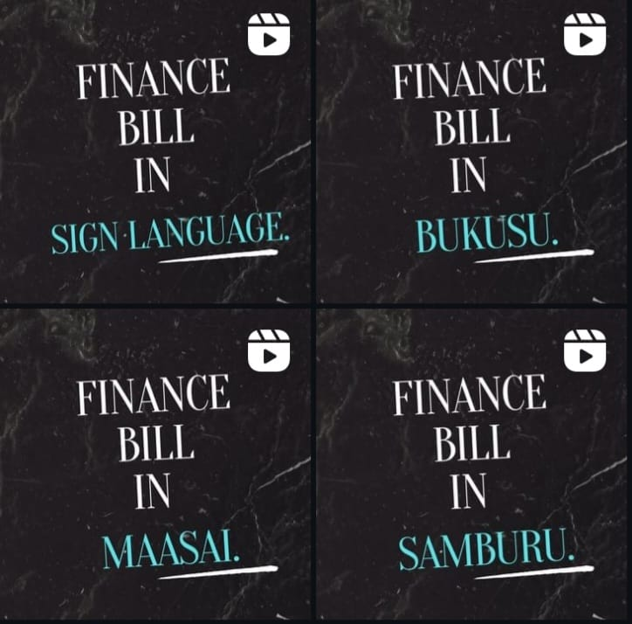
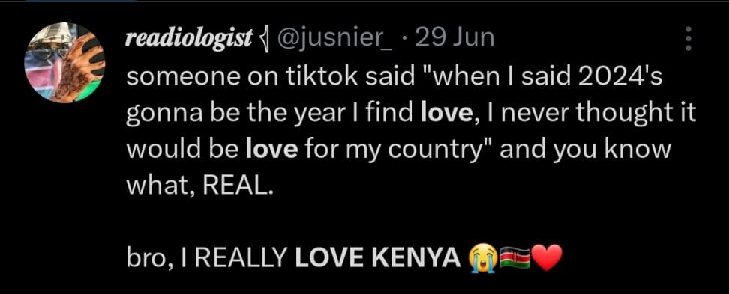
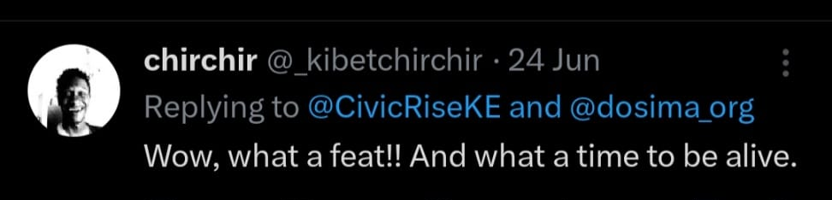
Understanding the current mood
BROKE
HEARTBROKEN
99% of Kenyans are feeling that their basic livelihoods are threatened
We are collectively deeply concerned about safety, security and human rights
ANGRY BUT OPTIMISTIC
CONSCIOUS COLLECTIVE
We are fiercely proud of being Kenyan but we hate Kenya
All rallying around the same positive outcome

Slide 4
Some have misread the room
A few brands have been caught flat footed when action was expected and demanded, losing trust due to a disconnect with consumer values
ISSUE
IMPACT
Ignoring social concerns
Loss of brand loyalty
Lack of transparency
Decreased trust (isolation)
Failure to adapt
Loss of relevancy or all the above

Slide 5
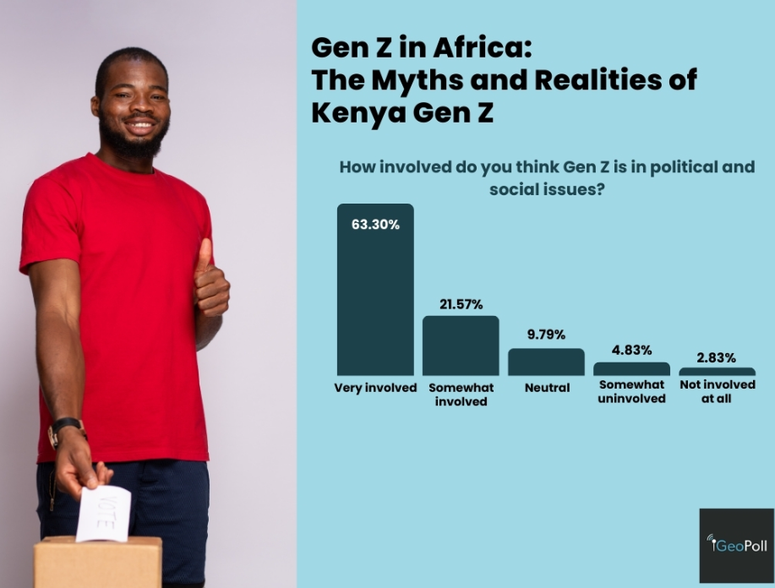

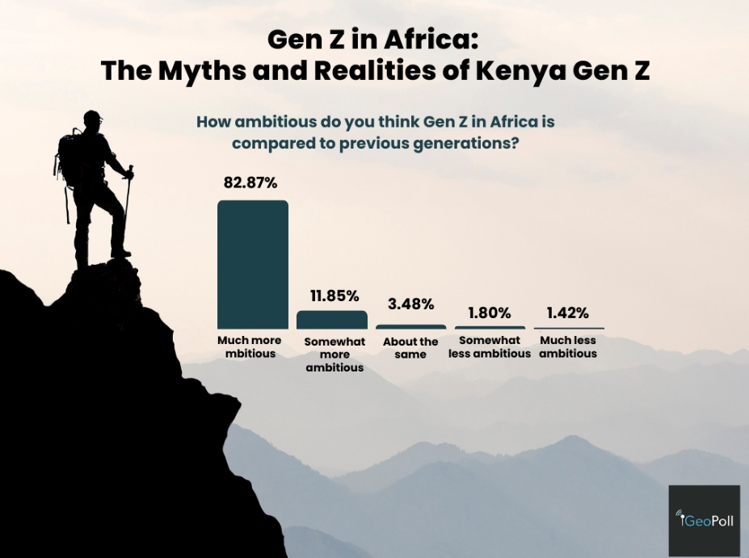
So, what do you do?
EMOTIONAL CONNECTION
Do the stories of the impact you’re creating resonate with your audience?
NOW
RELEVANCE
Does it matter in this moment?
AUTHENTIC vs. PERFORMATIVE
Are you able to earn and build trust through action?
NEXT

Slide 6

How do you do it?
Listen
1
Creating spaces for open dialogue and constructive feedback encourages engagement and fosters a sense of community and trust
Reflect your understanding
2
Honesty and transparency build trust and credibility, ensuring audiences
feel heard and respected and represented.
Use many voices
3
Align brand representatives with words to demonstrate commitment to values and solidify trust in the brand's purpose.
Define your role, then act
4
Align actions with words to demonstrate commitment to values and solidify trust in the brand's purpose.
Societal understanding + Business Purpose + Tangible Action +Judgement Criteria

Slide 7



What have we seen?
Some brands have successfully reconciled their values with public’s focus, resonating with conscious consumers
Easy
Medium
Hard
Spur of the moment
Undefined but beneficial
Activating in culture
Leaning on our collective Kenyan consciousness
Employee Engagement
Guidance
Public stand

Slide 8





Sustaining Brand – Public Harmony
Brands must continuously adapt to the evolving landscape and demonstrate their values are aligned with those of their customers
Contribute
Connect
Convince
Commercialise
Take actions which make a positive difference to the wellbeing and recovery of the community and wider society
Build and reinforce your b rands relationship with audiences and stakeholders, through valuable actions which contribute and reinforce your purpose and values
Connecting your brands products and services with the wider values and needs of the audience, reflecting their needs and priorities
Prompts and calls to action which drive sales, with relevant and appropriate messages

Slide 9
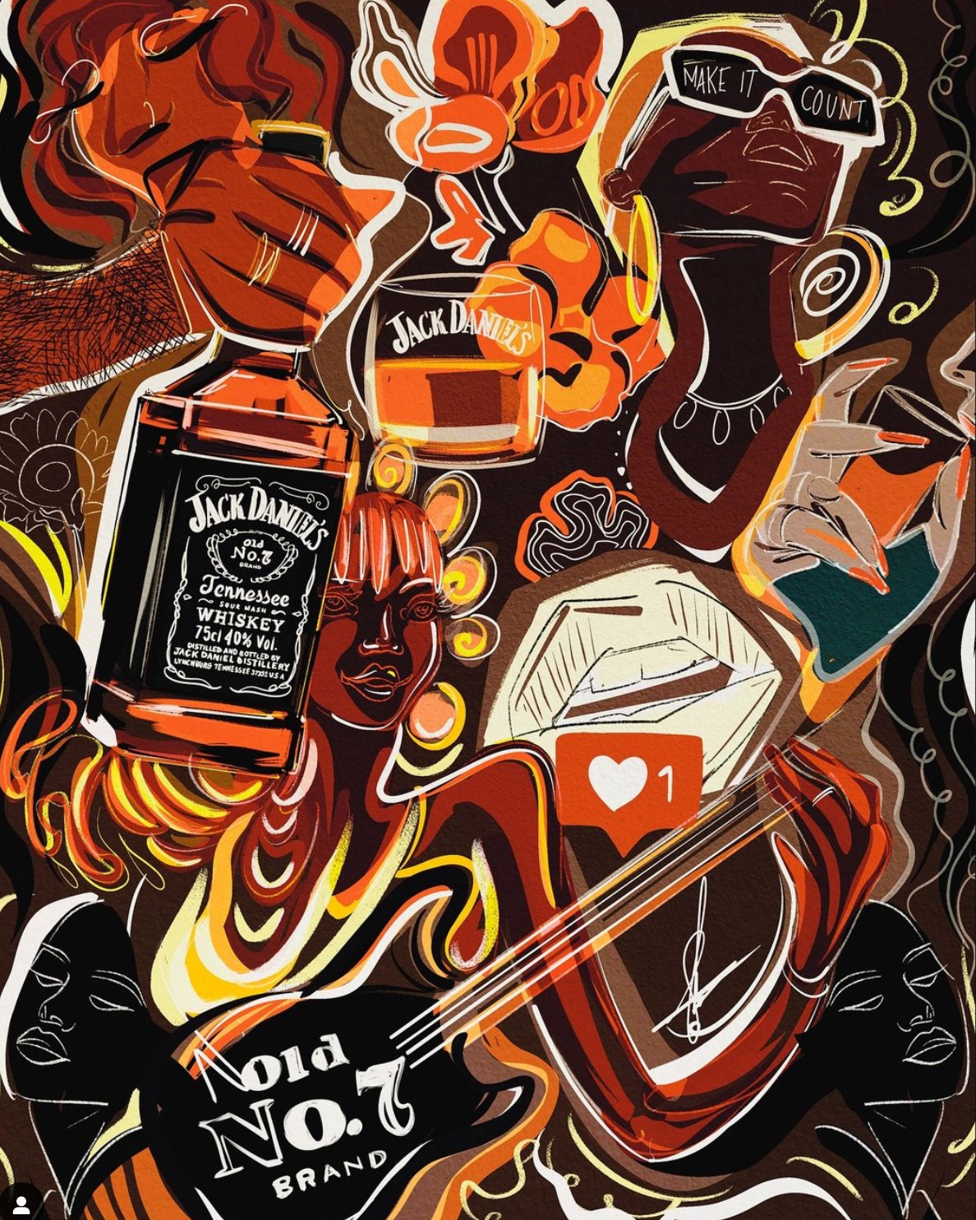
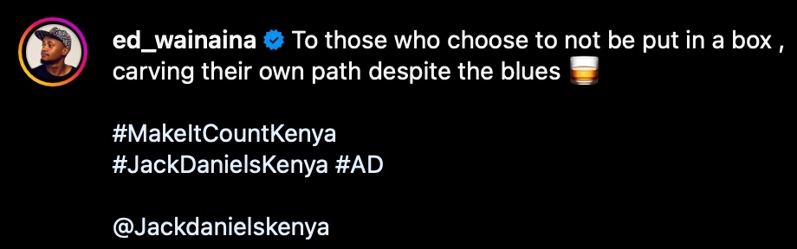
The influence dynamic
Circles of influence create communities easier and faster than brands.
1
Authenticity
2
Transparency
Consumers are increasingly discerning, and they value brands that genuinely care about their values and concerns.
Transparency builds trust and fosters a sense of connection with consumers who are seeking genuine and authentic brands.
3
Emotional Relief
4
Social Responsibility
By aligning with audience values, brands can create a safe place, a welcoming environment where consumers can be themselves.
Consumers are more likely to support brands that actively contribute to social good and promote positive change.

Slide 10

Your relationship with Influencers
Influence has very quickly moved beyond transactional, your relationships, and how you can use Influencers, has changed
Brands should not simply be engaging Influencers less tactically for communication:
Influencers can help us listen, demonstrate our understanding and connect with the many voices we should be using
Influencers can read the room better than us, they can tell us which of our activations are on-point, which are tone deaf
Influencers can roll up their sleeves and support our creative ideation across paid, earned and owned
Influencers are happy to engage tactically with you to ensure no matter how big or small your question, you can rely on trustworthy and up-to-the-second advice
ADVISORY PANEL
Coming soon…

Slide 11
THANK YOU

