Slide 1
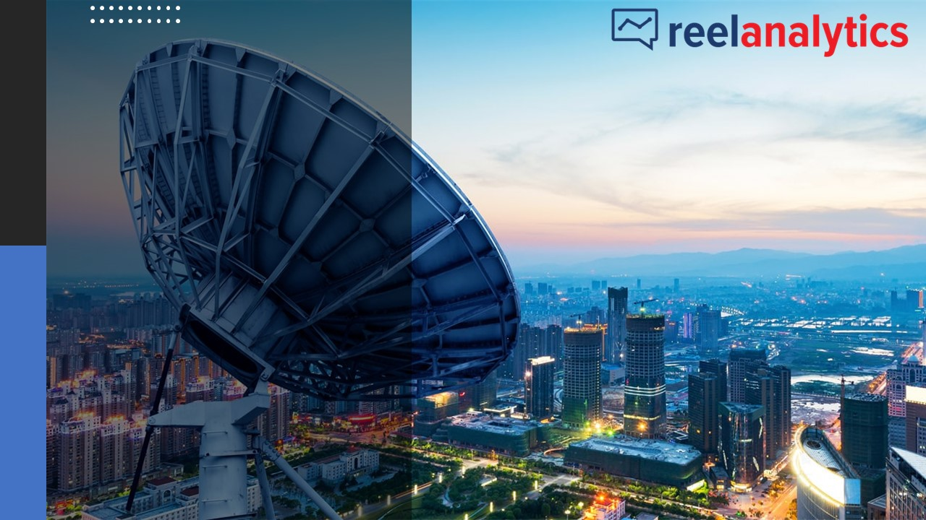
Kenya Media Landscape
Report
H1 2024

Slide 2
Content
1
3
Macro-Economic Outlook & Media Facts
Media Consumption Vs. Advertising
2
4
H1 Coverage Highlights & Advertising Trends
Conclusion and Forecast

Slide 3

Section 1: Macro-Economic Insights & Media Facts

Slide 4
Kenya Economic Outlook
GDP growth in 2024 is expected to slow down to 5.0%. This is according to the World Bank’s latest Kenya Economic Update (29th Edition), which adds that the 2023 growth was driven by the recovery of the agriculture sector, following improved weather conditions, and the services sector, with tourism and financial services contributing the most.
However, the outlook is subject to considerable risks, including tight global financing, drought, political instability, and slow recovery of global growth. Risk mitigation measures in the medium to long term include building fiscal and external buffers (e.g., foreign exchange reserves), strengthening disaster preparedness, and accelerating structural transformation.
Source: World Bank, Kenya National Bureau of Statistics

Slide 5
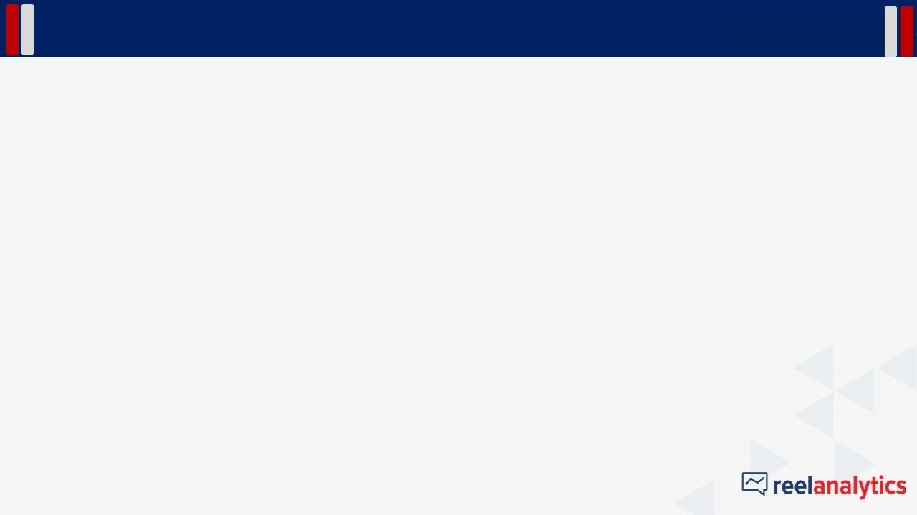
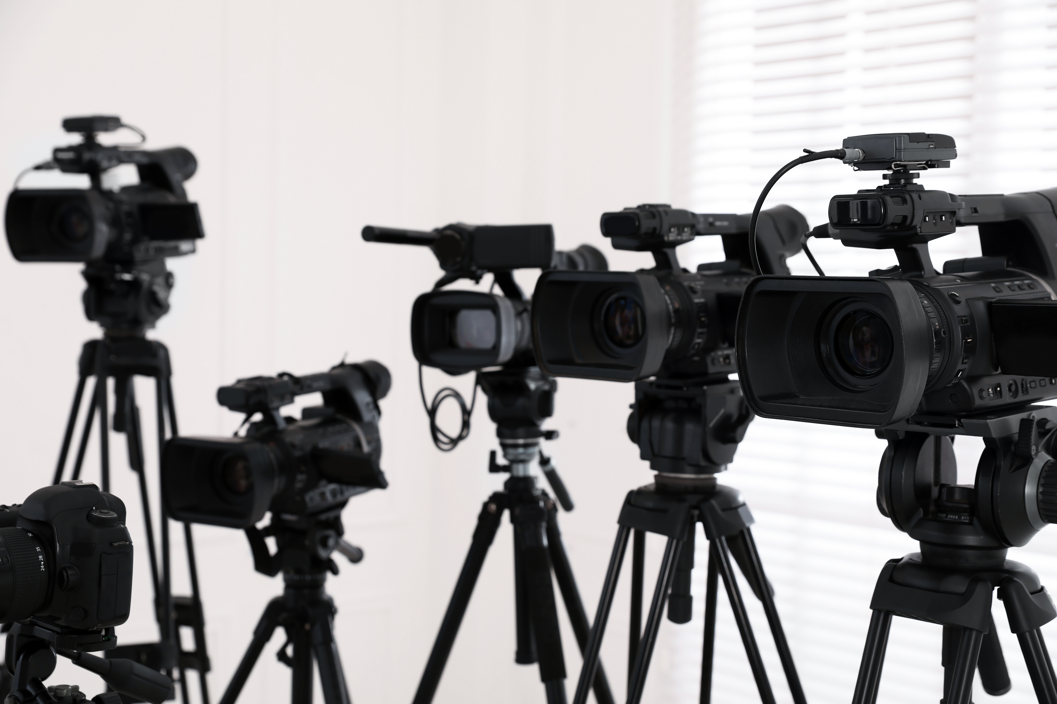
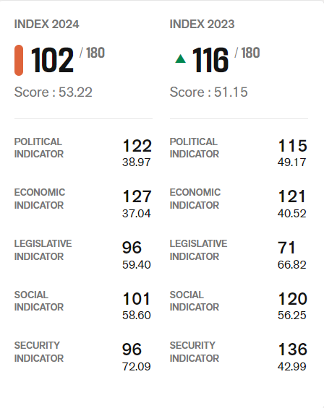
Media Facts- Press Freedom
Kenya's media sector is developed with a diverse and well-financed landscape. Despite this, media freedom gaps persist, as shown by Kenya's rank of 102 out of 180 in the 2024 World Press Freedom Index. Political influence, with many media outlets owned by politicians or their allies, is a key factor affecting press freedom in the country.
Attack On Reporters
Exclusive Publishers
Freedom Of The Press
After the 2022 General Elections, the Media Council of Kenya reported that 25 reporters were attacked by rioters and police. Such incidents can lead to media self-censorship to prevent further attacks or financial losses.
The government directed all its advertising through Kenya Broadcasting Corporation and granted exclusive publication rights to The Star, leading to concerns about reduced revenue sources for other media houses.
The journalistic freedom to report news in the public interest without interference or threats, as seen in Kenya's youth protests against governance issues, remains uncertain.
Source: Reporters Without Boarders , World Press Freedom Index

Slide 6
Media Evolution
The number of TV stations have been growing steadily from 2016. This is attributed to the digital migration in 2016 that saw a lot of investments digital TV media, especially in the digital terrestrial television (DTT) broadcasting platform. This has led to a faster growth in the number of TV stations compared to Radio. During the third quarter of 2023- 2024, the Communications Authority sector statistics report indicated that audiences had access to 351 television stations, which provide an extensive array of programming. Many of these TV and radio stations broadcast in multiple local languages, reflecting the country's rich cultural and linguistic heritage. This linguistic diversity helps ensure that content is accessible and relevant to various communities across Kenya, fostering a more inclusive media environment.
Source: Communications Authority of Kenya

Slide 7
Media Access
A review of media consumption by the Communications Authority in the quarter ending June 2024 revealed most respondents identified watching TV and listening to the radio as their most popular media activities. Although internet engagement remained stable, the data shows a modest increase in both radio and television consumption. Conversely, there was a slight decrease in magazine and newspaper reading during this period.
Source: Communications Authority of Kenya

Slide 8
Section 2: H1 Coverage Highlight & Advertising Trends

Slide 9




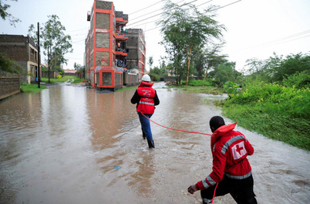
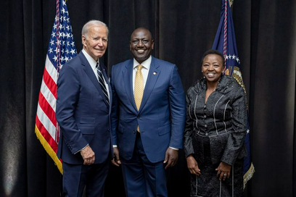
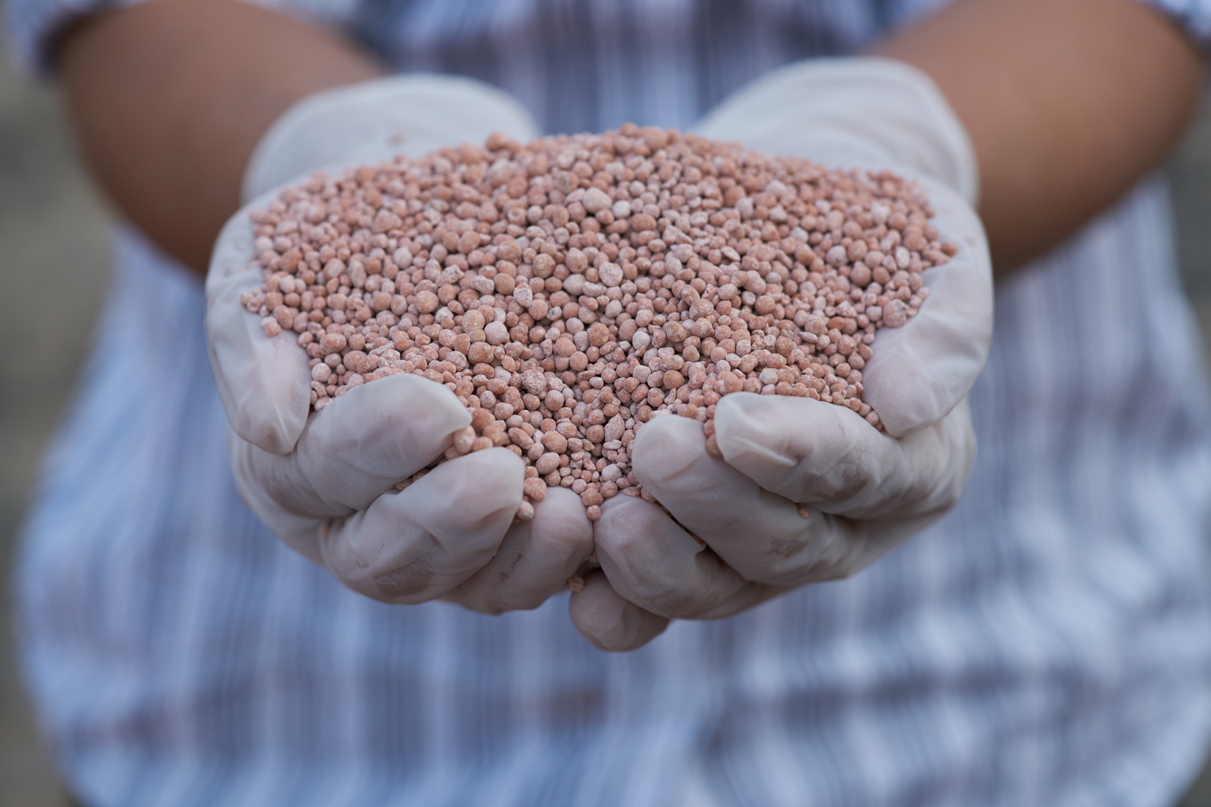

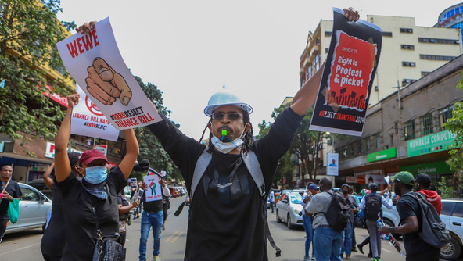
H1 2024 Highlights on PR coverage
End Femicide
State Visit
Haiti
On International Women’s Day, Kenyan women protested against rising femicide cases following 152 women murdered in 2023, the highest in five years, with 28 deaths reported this year.
President William Ruto made the first state visit to the United States by an African leader in 16 years, marking only the sixth state visit President Joe Biden has hosted since taking office.
Kenyan police officers have landed in Haiti for a UN-supported mission to aid in stabilizing the nation, facing opposition from Kenyans with a court challenge questioning the process's constitutionality.
Doctors Strike
Floods
Fake Fertilizer
Finance Bill Strike
Kenyan public hospital doctors ended a 56-day strike over salary arrears and immediate hiring of trainee doctors by signing a return-to-work agreement with the government.
This year’s long rains severely impacted Kenya, causing floods since mid-April that affected over 286,000 people, displaced 47,000 households, and resulted in 238 deaths across 37 counties.
Officials from the Ministry of Agriculture were accused of supplying substandard fertilizer, prompting the National Assembly to summon then Agriculture CS Mithika Linturi to explain how this fertilizer entered the market.
On June 25, 2024, thousands of protesters stormed Parliament Buildings in response to the passing of the Kenya Finance Bill 2024, part of a broader series of protests against proposed tax increases.

Slide 10
Trended Advertising Spends by Half Year
Overall advertising expenditure (on radio, TV, print, and OOH) in H1 2024 decreased by 19% compared to H2 2023.
Decline advertising expenditure between Jan-Jun 2024 was attributed to the media focus on political updates, flooding (in April and May) and protests related to 2024 Finance Bill.

Slide 11
Ad Spends by Industry
Betting and Gambling remained the top spending sector in H1 2024, despite a 38% decrease in ad spending compared to H2 2023. The reduction in expenditure by players in this sector was linked to new laws introduced to regulate betting among Kenya’s productive population. These laws include a 15% tax on the firm's gross gaming revenue and a further one percent monthly levy.
Finance, Personal Care, Communication, and State Bodies were among the sectors that recorded an increase in H1 ad spends (i.e. 51%, 16%, 13%, and 228% respectively). KCB, L'Oréal Group, Safaricom, and KRA were the top spenders in these sectors.
Base: KSh.38.9 B

Slide 12




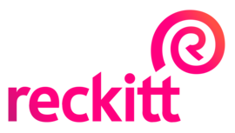



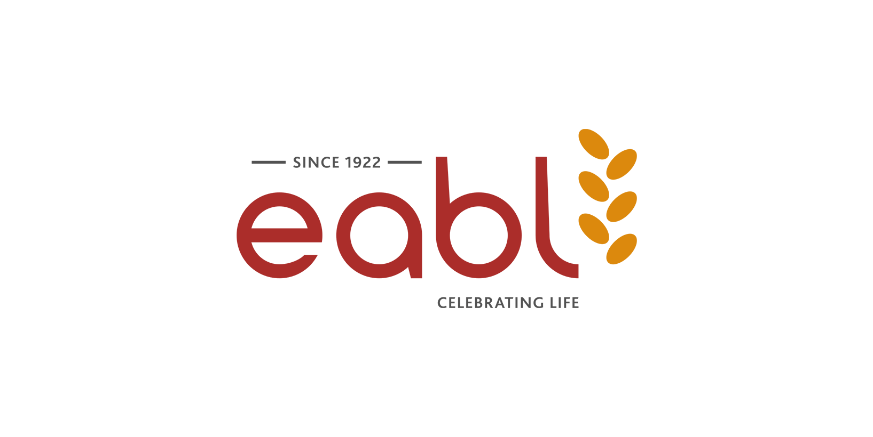
Top Spenders
Top 10 Spenders in H1 2024 (Millions)
MultiChoice Kenya Ltd
2,451
In the first half of 2024, MultiChoice was the highest spender, accounting for 6% of the advertising expenditure. During this period, the company focused its advertising efforts on the Showmax and Maisha Magic Plus. Further the company made significant investments in promoting its various DSTV and GOTV packages during major sporting events such as the UEFA Euro 2024, Olympics, and EPL.
Safaricom’s main advertising focus in H1 was on its Money Transfer services, Safaricom Open Market (devices) and the Chapa Dimba tournament. Meanwhile, KCB heavily invested in promoting its corporate brand through campaigns like “KCB Safari Rally” and “KCB Thematic.”
Safaricom PLC
1,878
Loreal Group
1,254
KCB
1,205
Heart Games
1,176
Reckitt Benckiser
1,123
Lotto
964
Shabiki
949
Coca-Cola
873
EABL
832

Slide 13
H1 2024 Industry Spends by Media
Base: KSh.15.0B
Base: KSh.20.9B
Base: KSh.1.1B
Base: KSh.2.0B

Slide 14
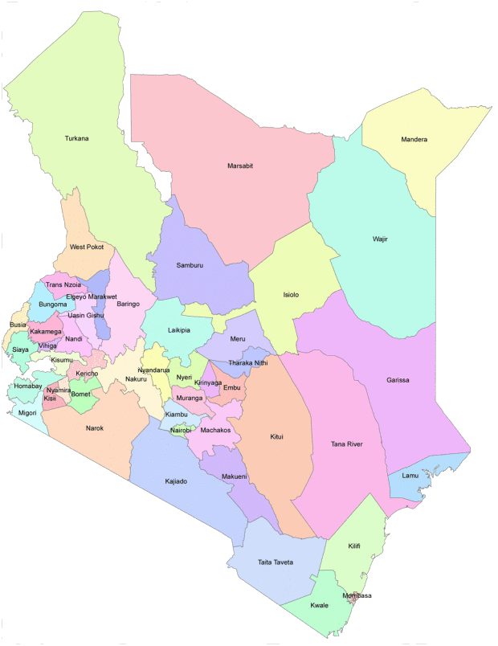
Large Format Sites Distribution by Town
Number of OOH sites by Town
Nairobi: 2,167
There has been a consistent proliferation of digital screens in the market with the screens mushrooming mainly in the main bus terminals in major towns across the country whereas the small vertical screens have cut a niche in malls, in stores and commercial and residential buildings across the capital.
The year has also seen strategic erection of mini billboards by Magnus at key transport intersections' within the capital.
Eldoret: 121
Meru 77
Bungoma: 21
Chuka 11
Kakamega 45
Kisumu 166
Kisii 38
Embu 53
Nakuru 200
Kilifi 63
Mombasa 190

Slide 15
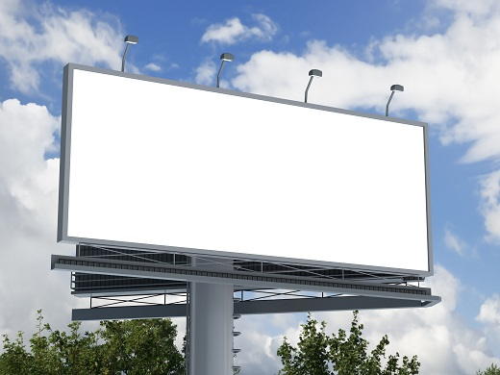
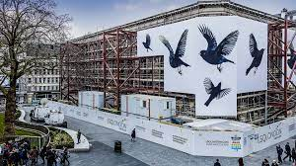
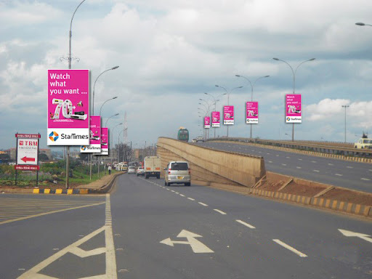
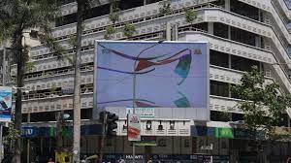
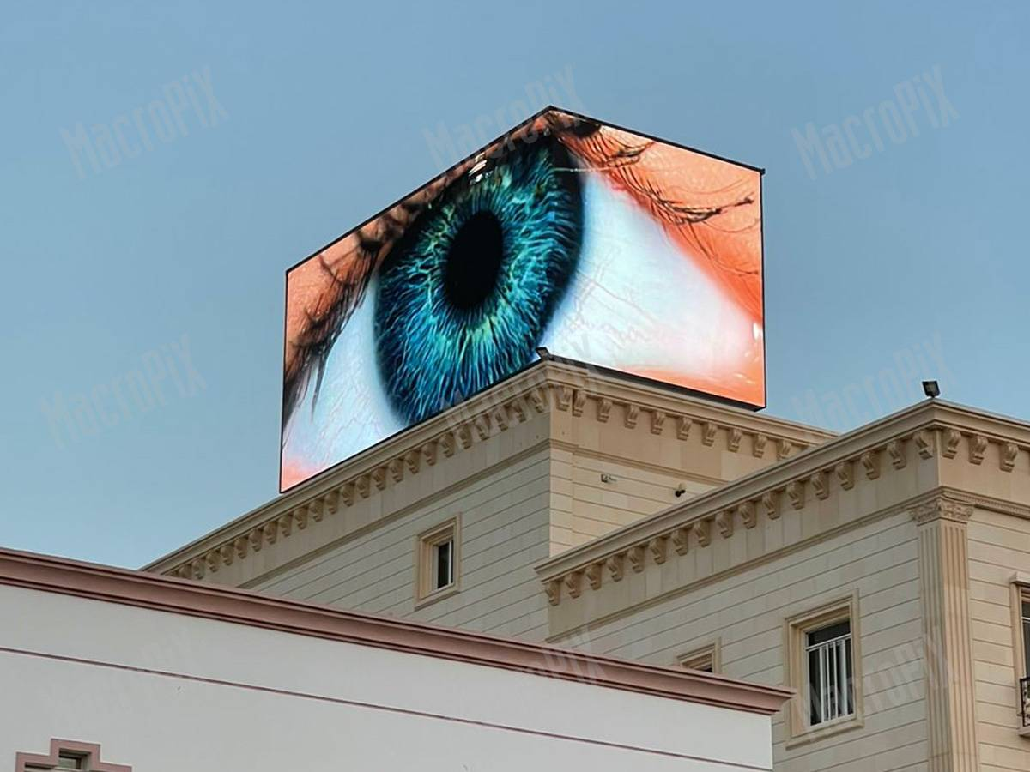

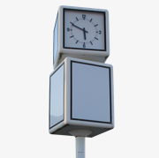

Overall Exposure by OOH Type
61%
Most of the billboards are in Nairobi due to heavy traffic and population density
2%
Mainly placed on iconic buildings.
Billboards
Wall Wraps
15%
Streetpoles are highly effective Within residential areas where there is high foot traffic.
2%
Have metamorphosized to residential and commercial buildings where vertical screens are strategically placed.
Digital Screens
Street Poles
13%
Bus Shelters & Bus Terminus
These form of OOH advertising is mainly used in towns
Erected at bus parks and terminals along busy roads
1%
Sky signs
5.6%
Are mainly in major intersections where they leverage on their muti faces to capture audiences from different directions
2%
These includes Bollards, Suburban, Mini Billboards, Construction site hoarding, Diecut, Bridge Banner
Clocks
Other OOH Sites
5,142 Total OOH sites countrywide

Slide 16
Radio Advertising vs. Listenership
The radio category has seen exponential growth over the last ten years largely driven by the launch of numerous vernacular stations broadcasting in local languages. This has led to a high audience affinity to these stations because the listeners tend to trust messages more when they broadcast in their vernacular languages. Radio Listenership and advertising is however highest on Swahili Radio Stations due to their extensive nationwide reach.
Listenership Share
Ad Spends Share
Radio Ad Placements Vs. Listenership
Source: Reelanalytics, MCK

Slide 17
TV Advertising vs. Viewership
Citizen TV has the highest viewership nationally in the Kenyan market- attributed to it’s nature of programming. TV Viewership across most stations is highest on prime-time slots from the 7 PM news through to 22:00 Hrs. Regional TV stations such as Inooro Tv also enjoy substantial advertising investments as brands seek to reach niche audiences.
Viewership Share
Ad Spends Share
TV Ad Placements Vs. Viewership
Source: Reelanalytics, MCK

Slide 18
Social Media Use
The rapid growth of mobile phones, mainly smart phones has been responsible for Kenya having one of highest internet penetration rates in Africa. Growth in data subscribers has led to massive investments by mobile operators and Internet Service Providers to increasing bandwidth. Kenya's largest telecoms operators, Safaricom and Airtel have already launched their 5G high-speed internet service. These high levels of smart phone devices and internet penetrations had led to increased usage of social media platforms, Mainly for news, entertainment and networking. Facebook and WhatsApp stand out as the top social media platforms in Kenya. Following closely in popularity, TikTok and YouTube secure the third and fourth positions.
Devices used to Access the Internet
Most Used Social Sites
Source: Communications Authority of Kenya

Slide 19
Section 3: Conclusion and Forecast

Slide 20
Rate Card Values Ad Spends Forecast for TV, Radio, Print and OOH
Conclusions & Forecast
Advertising spends trend curve on TV, Radio, Print and Out of Home Platforms is expected to remain relatively flat with a marginal growth of 1% in the second Half of 2024 compared to the first half. This is based on time series data which indicates that advertising spends across most industries have been in decline trend from the second half of 2021. Advertising spends in the first half of 2024 are projected to drop further in H1 2025 by 7% if all factors remain constant. Some of the factors that have contributed to this decline include the Impact of Government Regulations on Businesses such as excise duty on betting / gambling brands, Government’s directive to advertise solely on the National Media Outlets and the introduction of new statutory deductions such as the housing levy. Many business have complained of increased operational costs from these regulations which poses significant challenges especially for small businesses.

Slide 21


