Slide 1
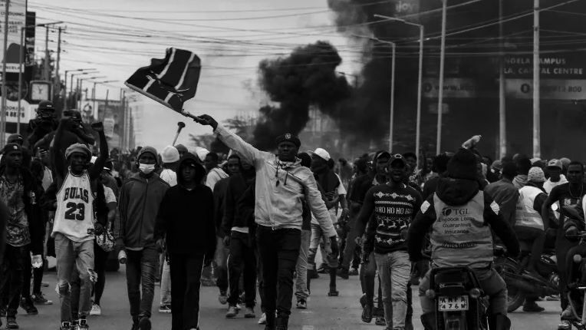

#Reject #Occupy #Revolution #MOVEMENT
Updated Sentiment Presentation

Slide 2
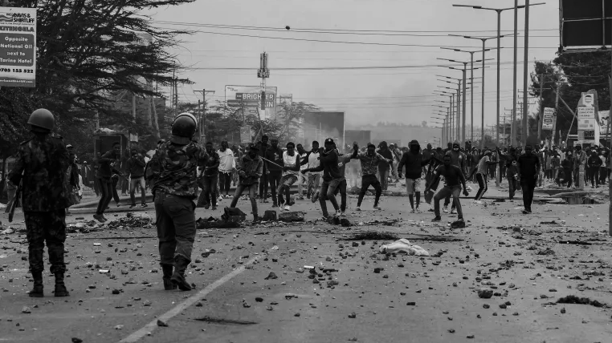
What if I told you
The events were predictable.

Slide 3
The signs were there weren’t they?

Slide 4
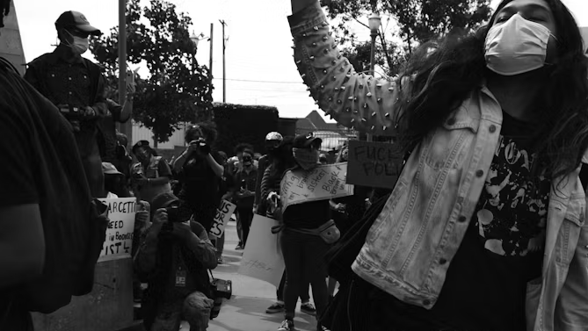
People kept telling us about Gen Z

Slide 5
“Don’t mess with Gen Z because they will drag you through the mudd” @NonieMaingi

Slide 6


Slide 7
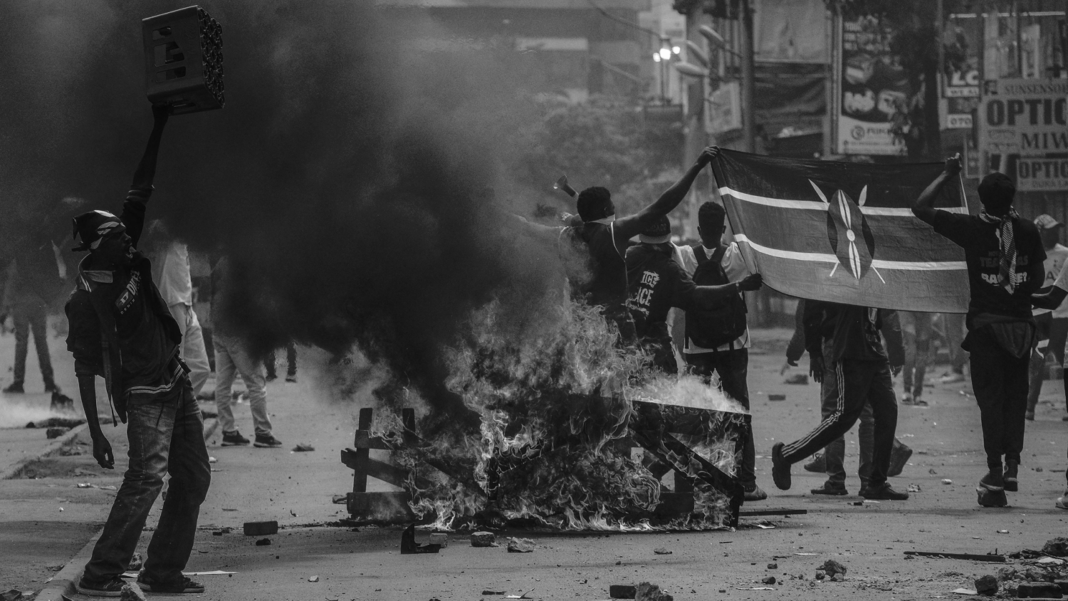
We were telling clients…

Slide 8

CULTURAL
CULTURAL
TRUTH
TRUTH
As a Generation Gen Z will stand up against oppressive structures

Slide 9
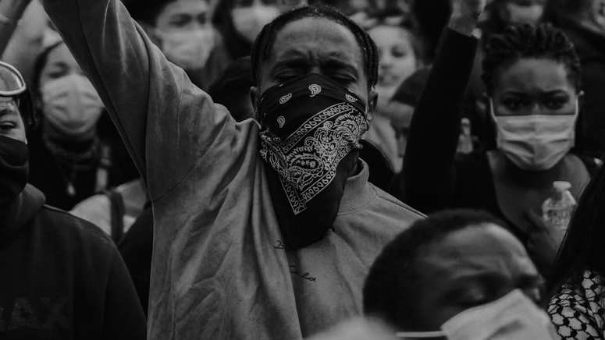
We saw something…
We sensed something…
We did something…

Slide 10


FIGHT THE SYSTEM.
This is our platform idea.

Slide 11
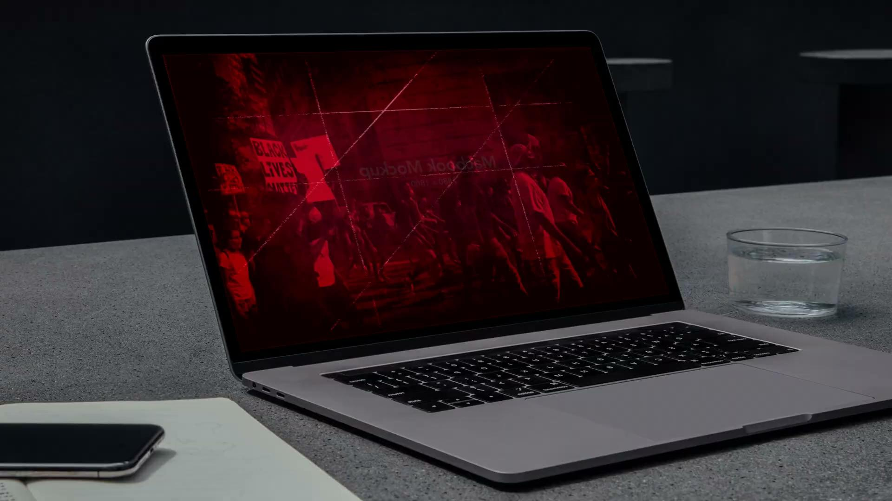

Slide 12
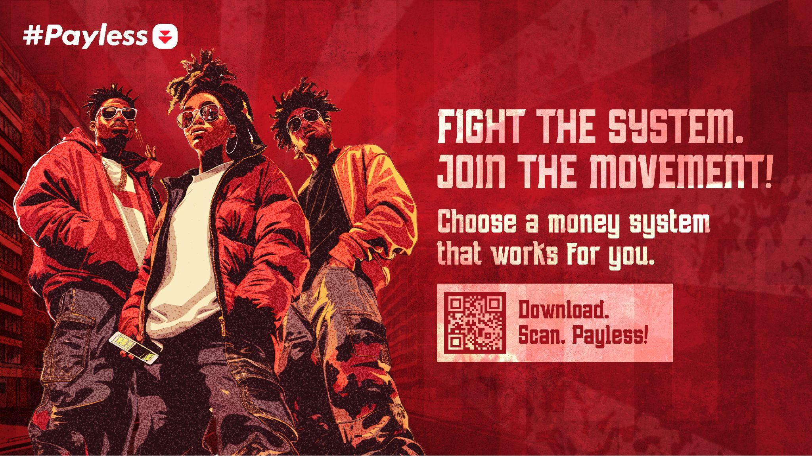

Slide 13
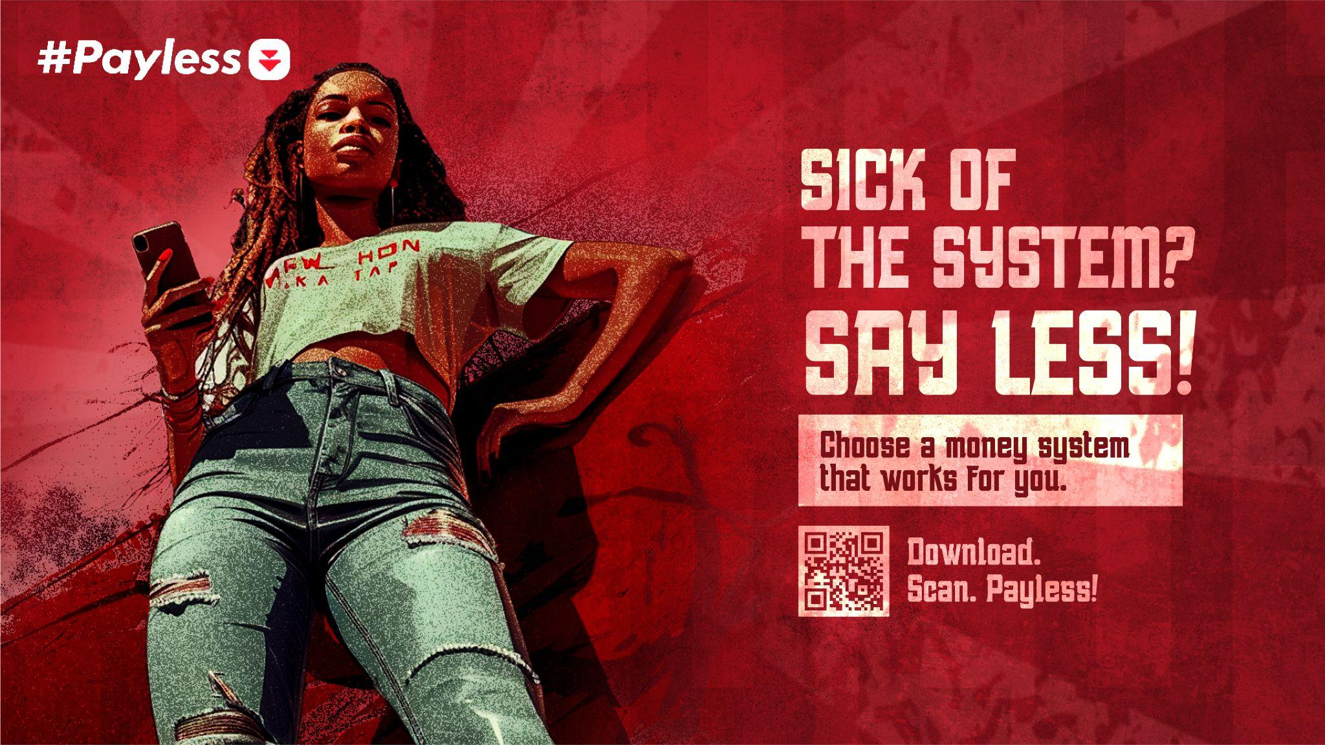

Slide 14


Slide 15
We use sentiment for brand results

Slide 16
Payless Results

Slide 17
Overall Sentiment
300K Downloads
9.73M Impressions
KE
87.9% net sentiment ratio
(positive and neutral)
Increase in brand reach, recognition, and social media engagement

Slide 18
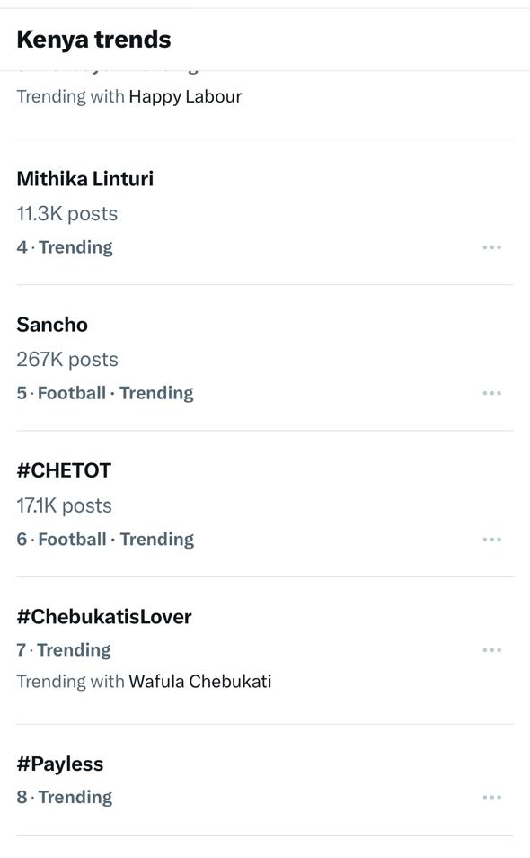
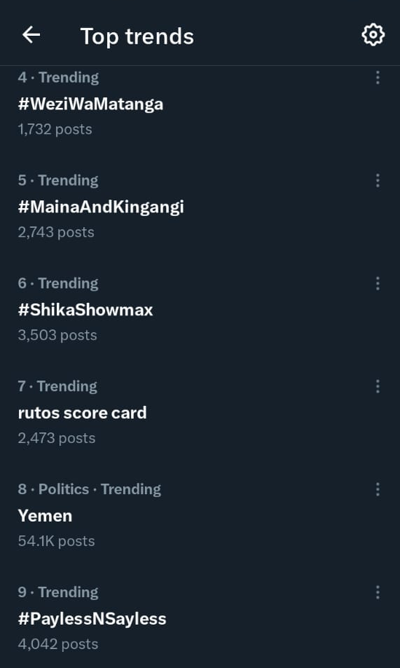
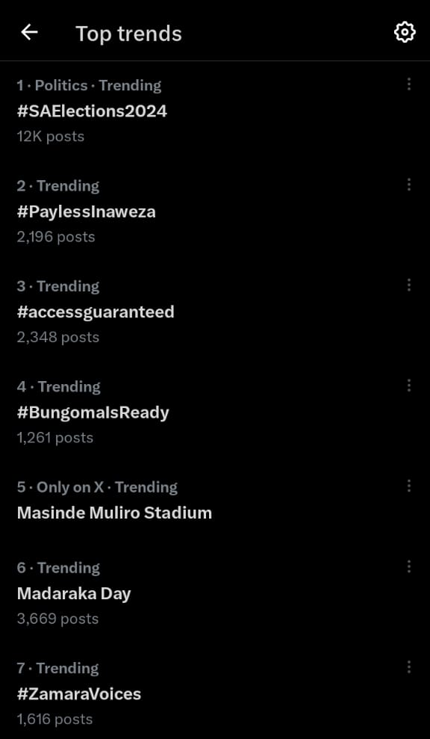
Trending Topic - Conversations

Slide 19

We can’t predict the future.
No one can but you can use the signs.

Slide 20
Use sentiment to find emotion that brands can leverage on

Slide 21
Let’s look at #RejectFinanceBill2024
#RutoMustGo

Slide 22
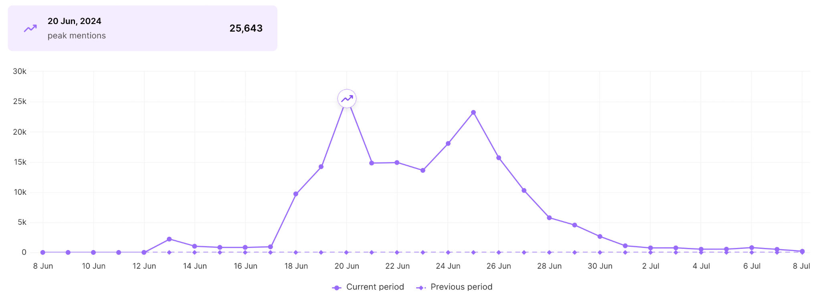
Finance Bill Conversation.

Slide 23
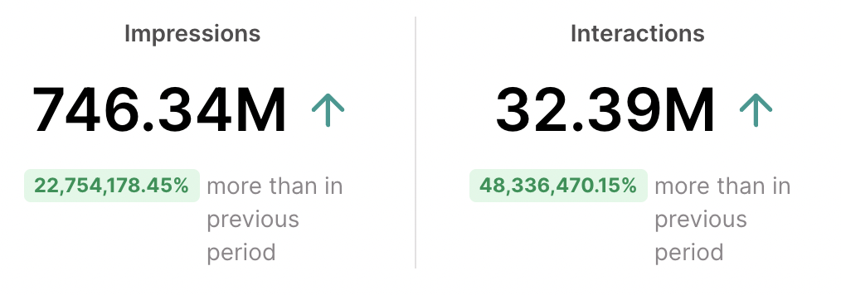
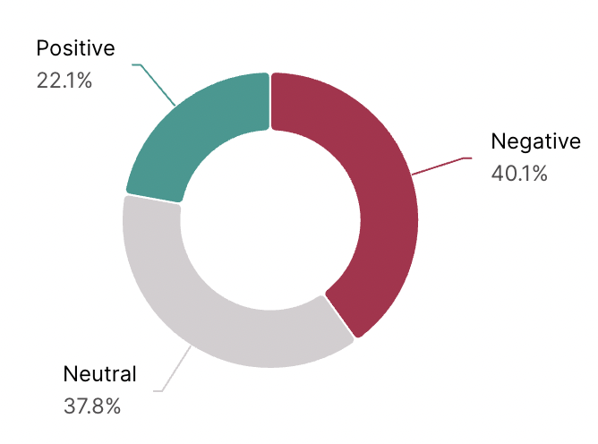
Finance Bill: Conversation Volume
As at July 8th, the conversation around the bill had reached close to 750M impressions, 32M interactions and a negative sentiment of 40%
Note:
Interactions: Users engaged in the conversation
Impressions: No of times content is served/seen by the interacting users

Slide 24
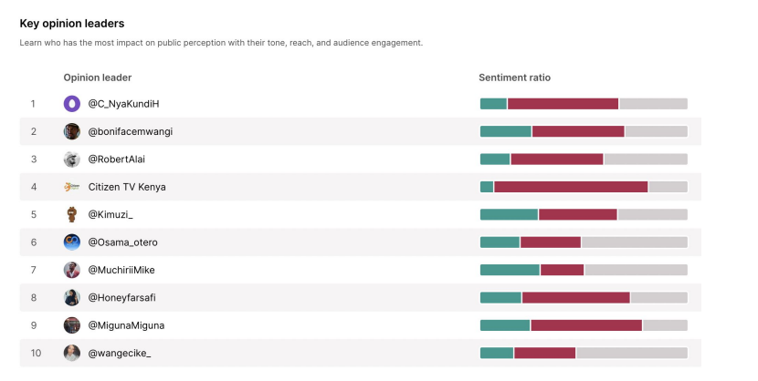
Key Opinion leaders #RejectFinanceBill

Slide 25
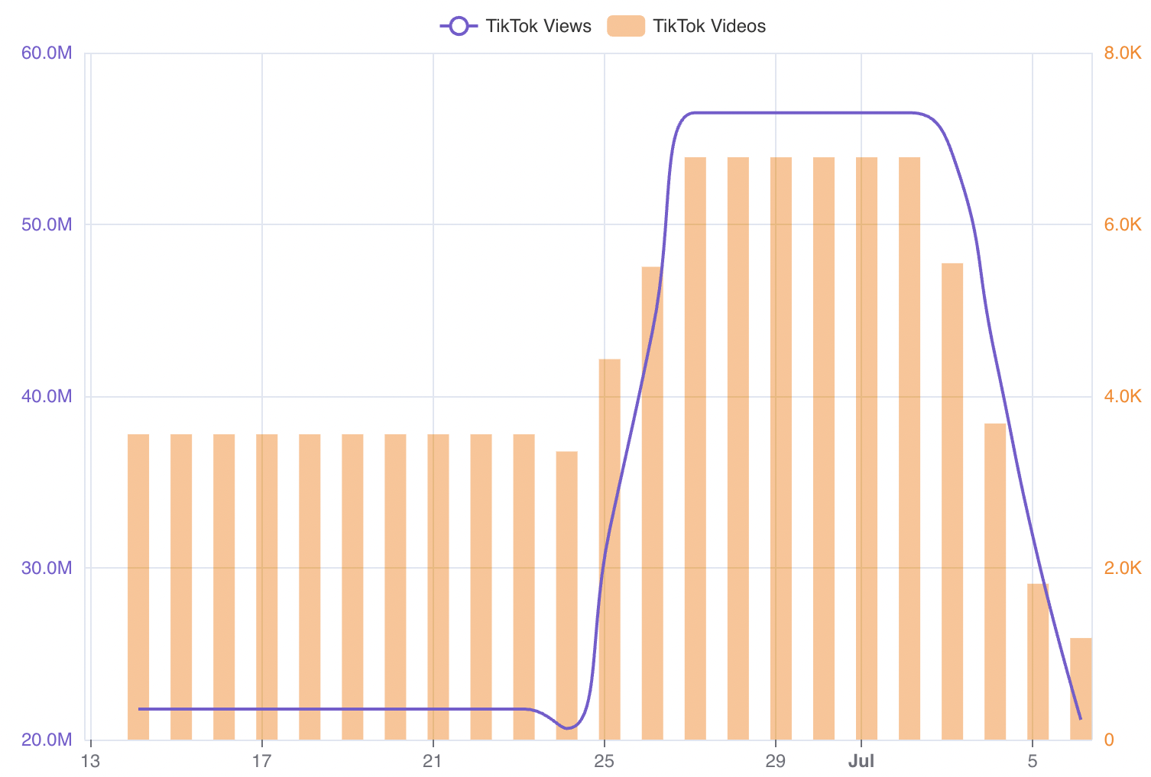
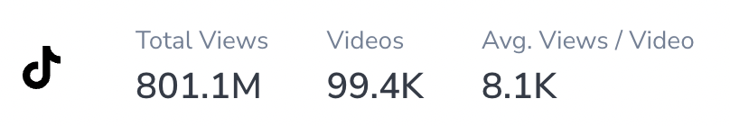
#RejectFinanceBill2024 on TikTok
This is a tracking of #rejectfinancebill2024 and associated hashtags e.g #rejectfinancebill
Close to 100k videos views have been generated, leading to over 800 million views on TikTok.
In comparison, this is double the views on the hashtag #RutoMustGo

Slide 26
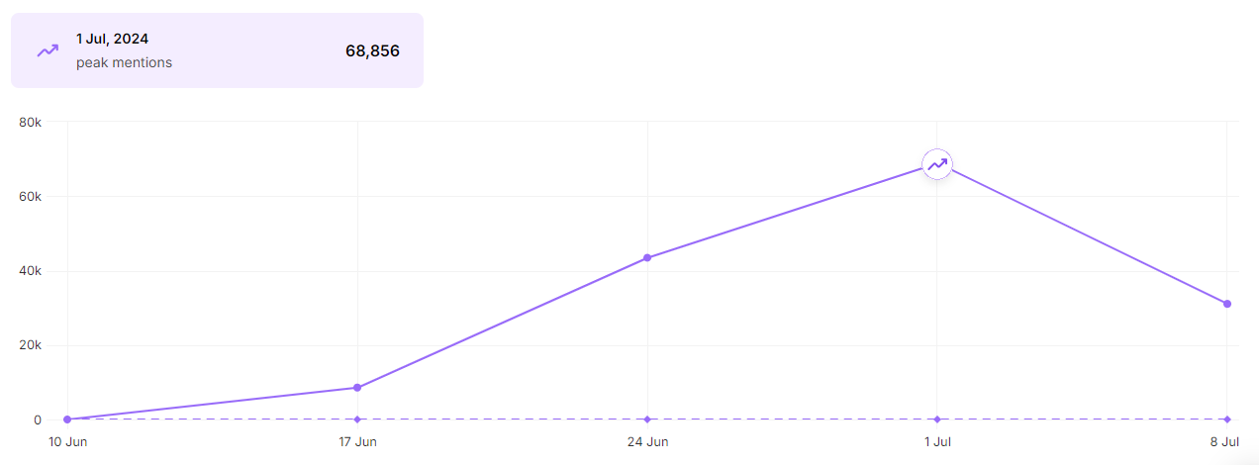
Conversation then shifted to #RutoMustGo which hit a peak on July 1st

Slide 27
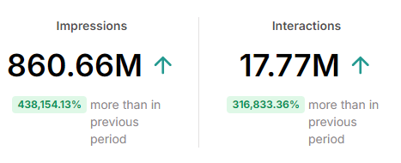
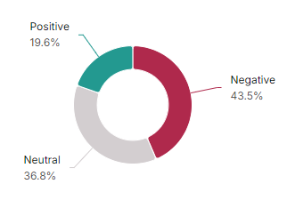
#RutoMustGo : Conversation Volume
June 1st to July 8th
This has had 17M interactions, generated over 860 Million impressions.
Note:
Interactions: Users engaged in the conversation
Impressions: No of times content is served/seen by the interacting users

Slide 28
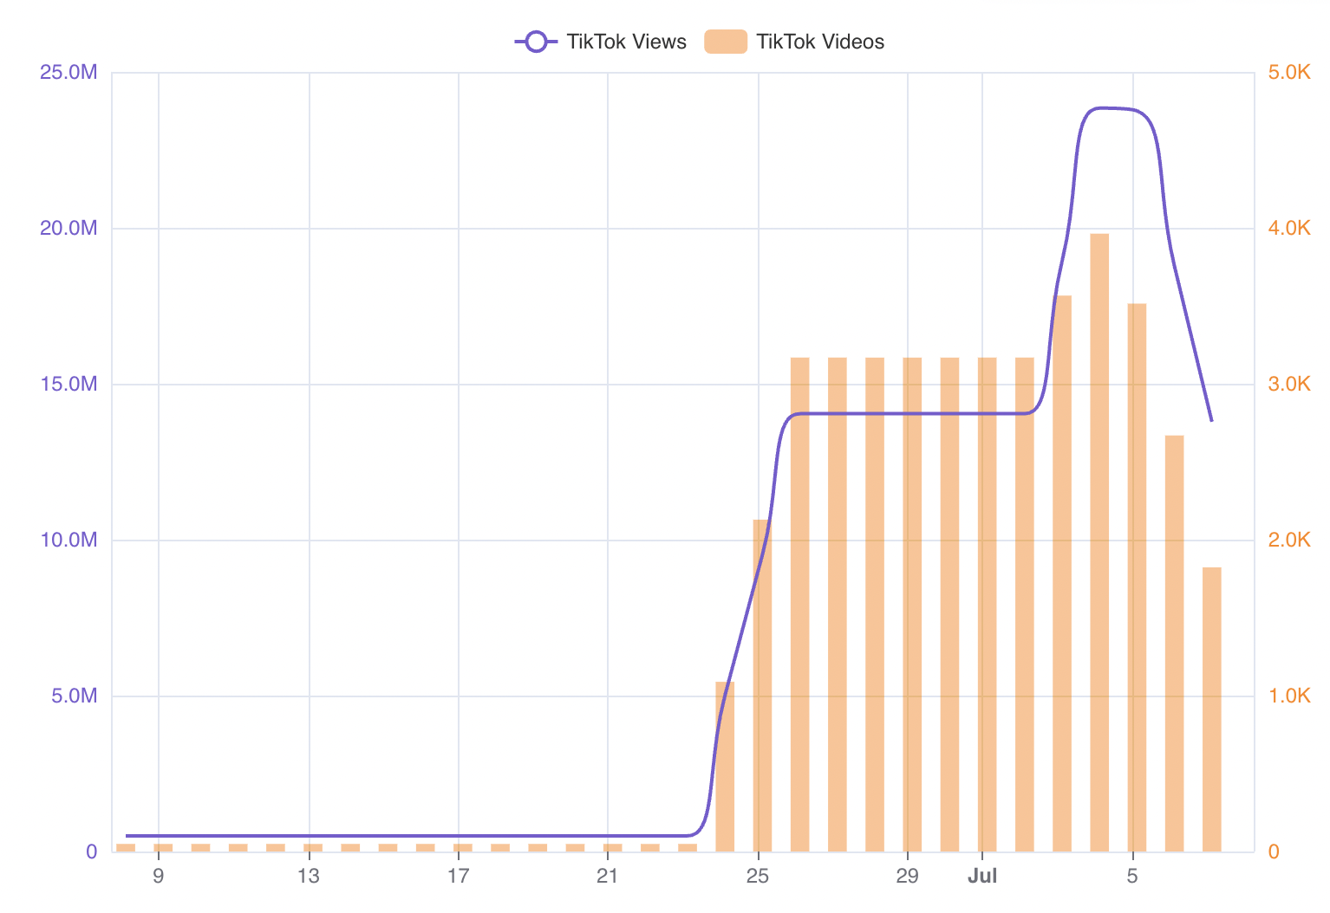
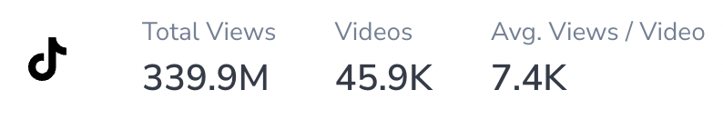
#RutoMustGo on TikTok
It’s a top trending hashtag on TikTok generating an average of 14M daily views, and 3k+ videos being published every day. The peak was on July 4th - close to 24 million video views on that specific day.
Overall, there’s been close to 340 million video views from 46k+ videos.
The trend is reducing in popularity on this channel as well.

Slide 29
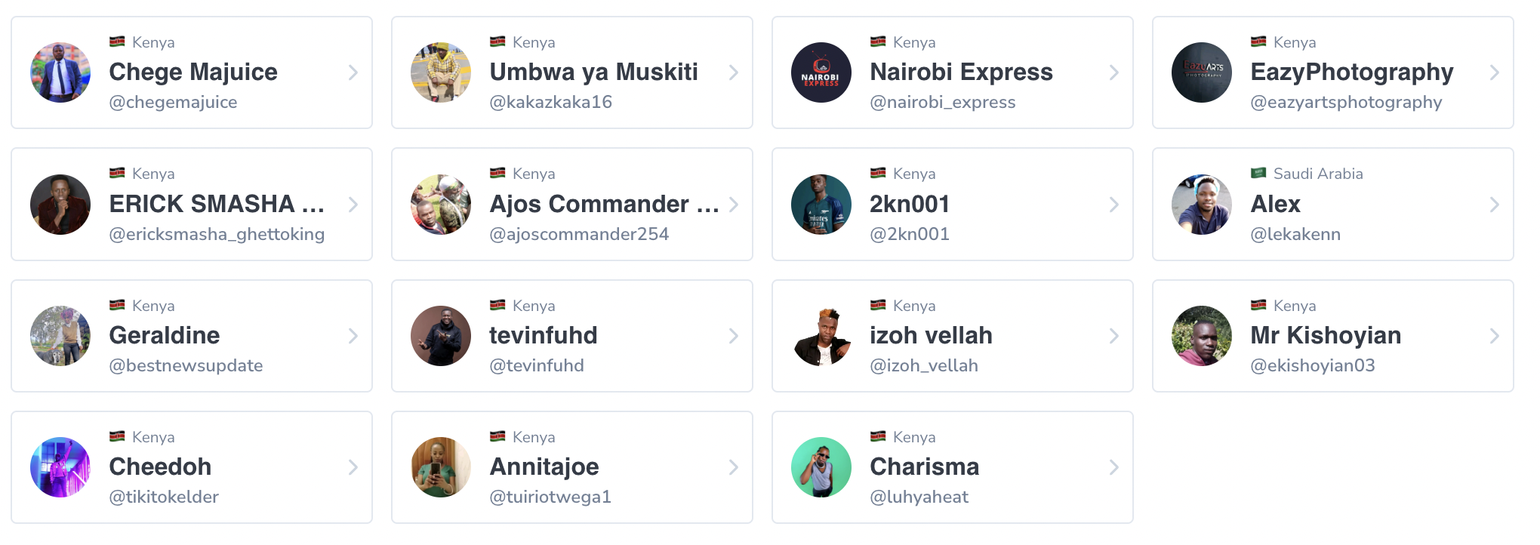
#RutoMustGo : Leading voices on TikTok
The leading voices on TikTok are a reflection of the ordinary netizens. Unlike on X where the leading voices are a representation of popular activists, influencers, politicians and media houses. This highlights the virality of the TikTok platform where content takes precedence not the creator.

Slide 30
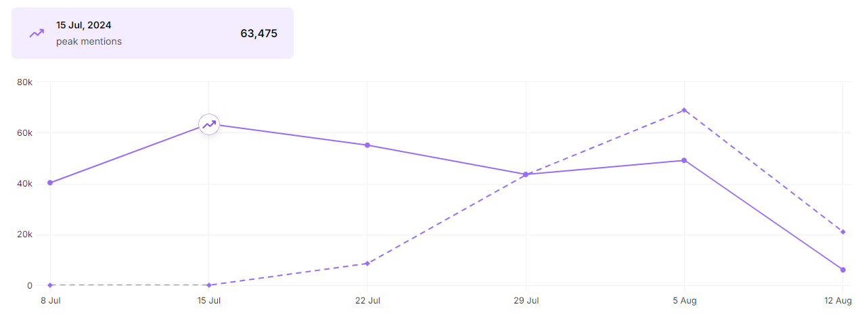
#RutoMustGo 8th July to 13 August

Slide 31
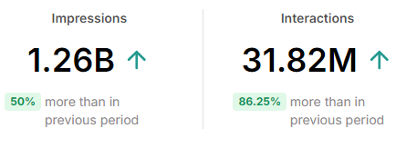
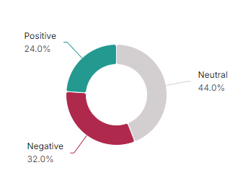
#RutoMustGo : Conversation Volume
July 8th to August 13th
During this period the Interactions increased but the Negative Sentiment also declined with Neutral becoming a majority. (Broad Based Government Supports entered the Chat)
Note:
Interactions: Users engaged in the conversation
Impressions: No of times content is served/seen by the interacting users

Slide 32
We looked at #RutoMustGo from June to August

Slide 33
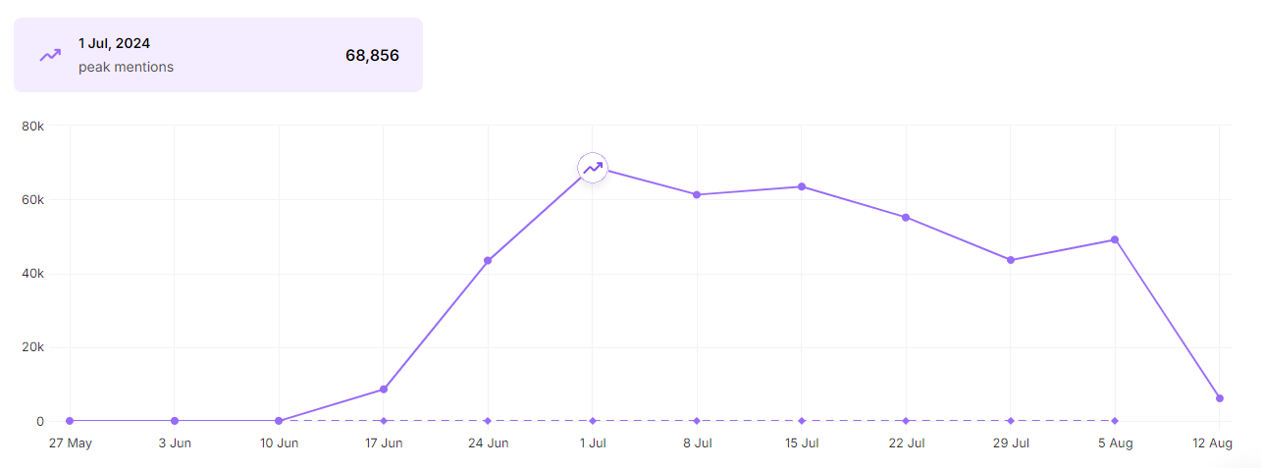
#RutoMustGo 1st June to 13th August

Slide 34
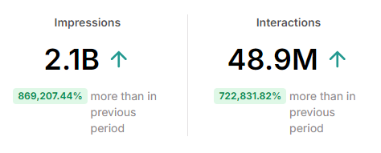
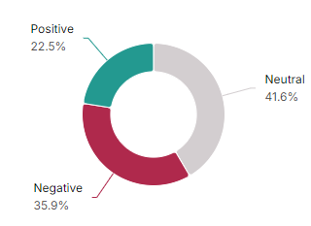
#RutoMust go Conversation Volume June to August
The interactions were nearly enough for each Kenyan with over 2 Billion Impressions.
Key thing is the Sentiment was neutral at 41.6% with 35.9% Negative and 22.5% Positive.
Note:
Interactions: Users engaged in the conversation
Impressions: No of times content is served/seen by the interacting users

Slide 35

Tone of voice
The general tone of all the texts is incendiary, revolutionary, and urgent, calling for the resignation of the President and his regime with a strong focus on mobilization and activism.

Slide 36
You can’t Ignore New Media

Slide 37
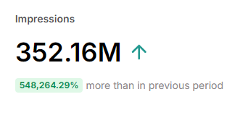
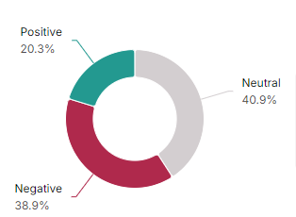
#RutoMustGo Conversation Volume on X by New Media 1st June to 8th July
Note:
Interactions: Users engaged in the conversation
Impressions: No of times content is served/seen by the interacting users

Slide 38
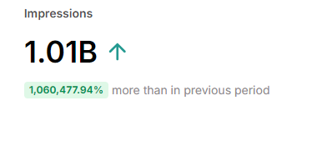
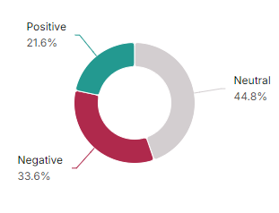
#RutoMust go Conversation Volume on X by New Media June to August
Note:
Interactions: Users engaged in the conversation
Impressions: No of times content is served/seen by the interacting users

Slide 39
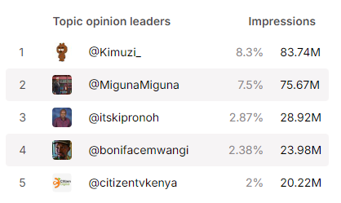
#RutoMustGo Opinion leaders on X by New Media June to August
Note:
Interactions: Users engaged in the conversation
Impressions: No of times content is served/seen by the interacting users

Slide 40
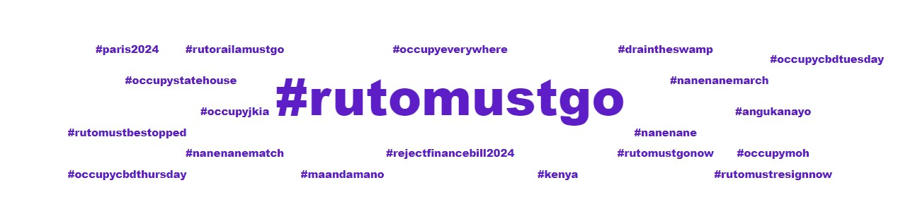
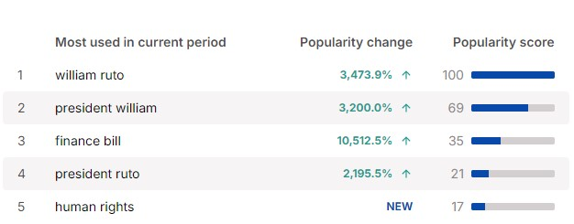
New Media hashtags

Slide 41
What about Mainstream Media & News sites

Slide 42
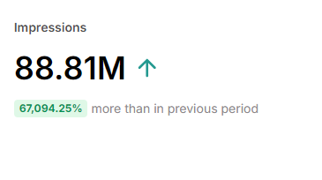
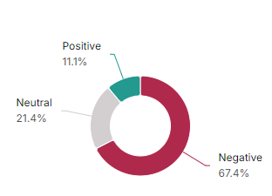
#RutoMust go Conversation Volume 1st June to 8th July on News websites
Note:
Interactions: Users engaged in the conversation
Impressions: No of times content is served/seen by the interacting users

Slide 43
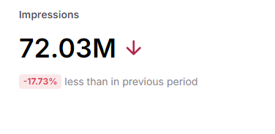
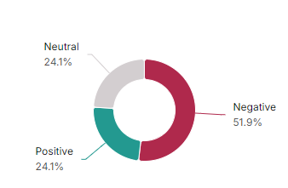
#RutoMust go Conversation Volume
8th July to 13th August on News websites
Note:
Interactions: Users engaged in the conversation
Impressions: No of times content is served/seen by the interacting users

Slide 44
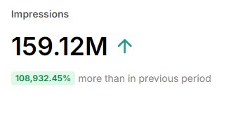
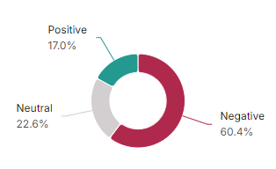
#RutoMust go Conversation Volume June to August on News websites
Note:
Interactions: Users engaged in the conversation
Impressions: No of times content is served/seen by the interacting users

Slide 45
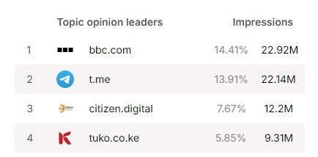
#RutoMust go Conversation Volume June to August
Note:
Interactions: Users engaged in the conversation
Impressions: No of times content is served/seen by the interacting users

Slide 46
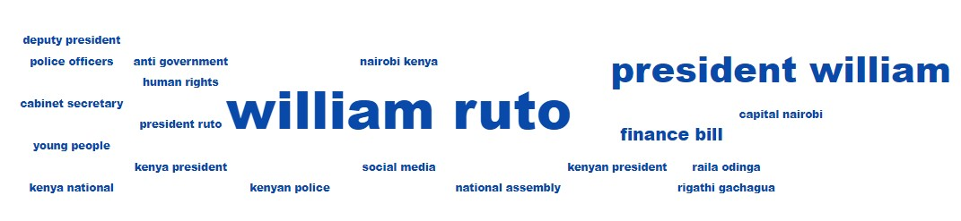
News Sites word Cloud

Slide 47
Interesting observations.

Slide 48
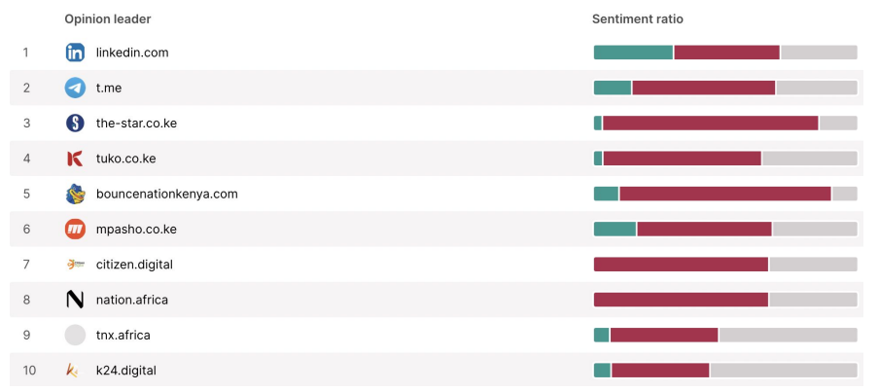
LinkedIn was more positive than any other publisher

Slide 49
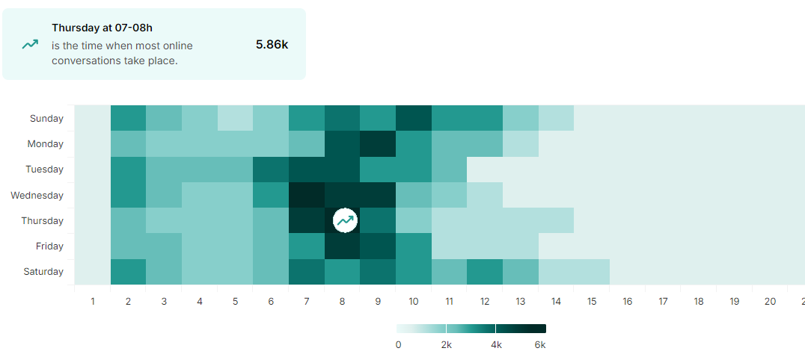
When conversations were happening Especially on X

Slide 50
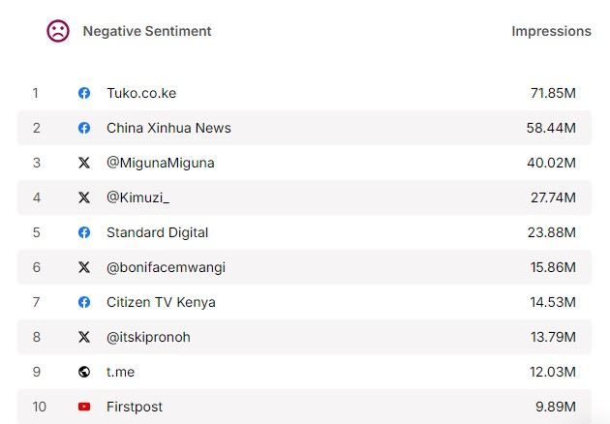
Negative sentiment Opinion leaders

Slide 51
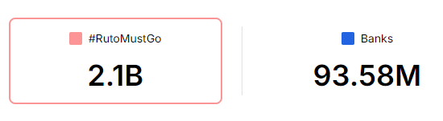
Impression Comparison to 5 Bank Brands
Bank Brands: Equity, Coop Bank, NCBA, KCB, BOA.

Slide 52
Conclusion

Slide 53
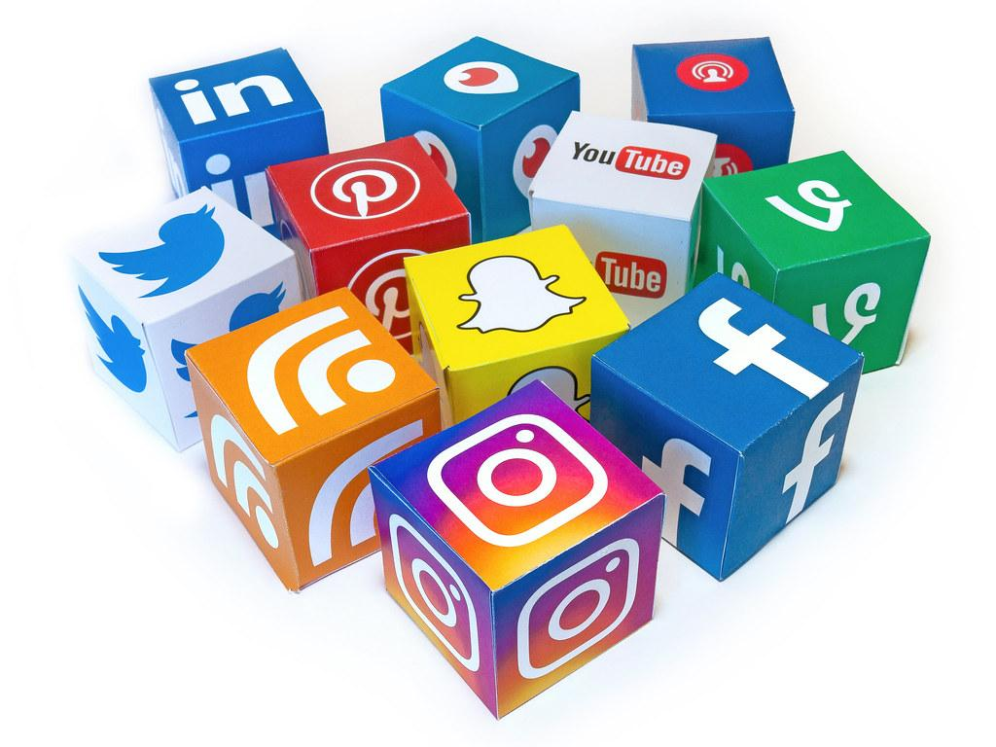
You have to pay attention New Media
Platforms play a big role in how messaging spreads.
Brands haven’t figured how to fully use and unlock a lot of new media which drives a lot of Sentiment.

Slide 54
Media houses have embraced social
Traditional Media Still plays a big role in how perception is shaped.
How they report events and news makes a big difference. If media is not free, we may have different perceptions overall.
Media validates conversation or invalidates them. That’s the POWER of Traditional media houses.

Slide 55
Brands
Use Sentiment as tool not only when in crisis but to garner insights and see what to fix as you build your Brands.
We are living in interesting times as Marketers.

Slide 56
Talk to us about using Brand Sentiment.

Slide 57
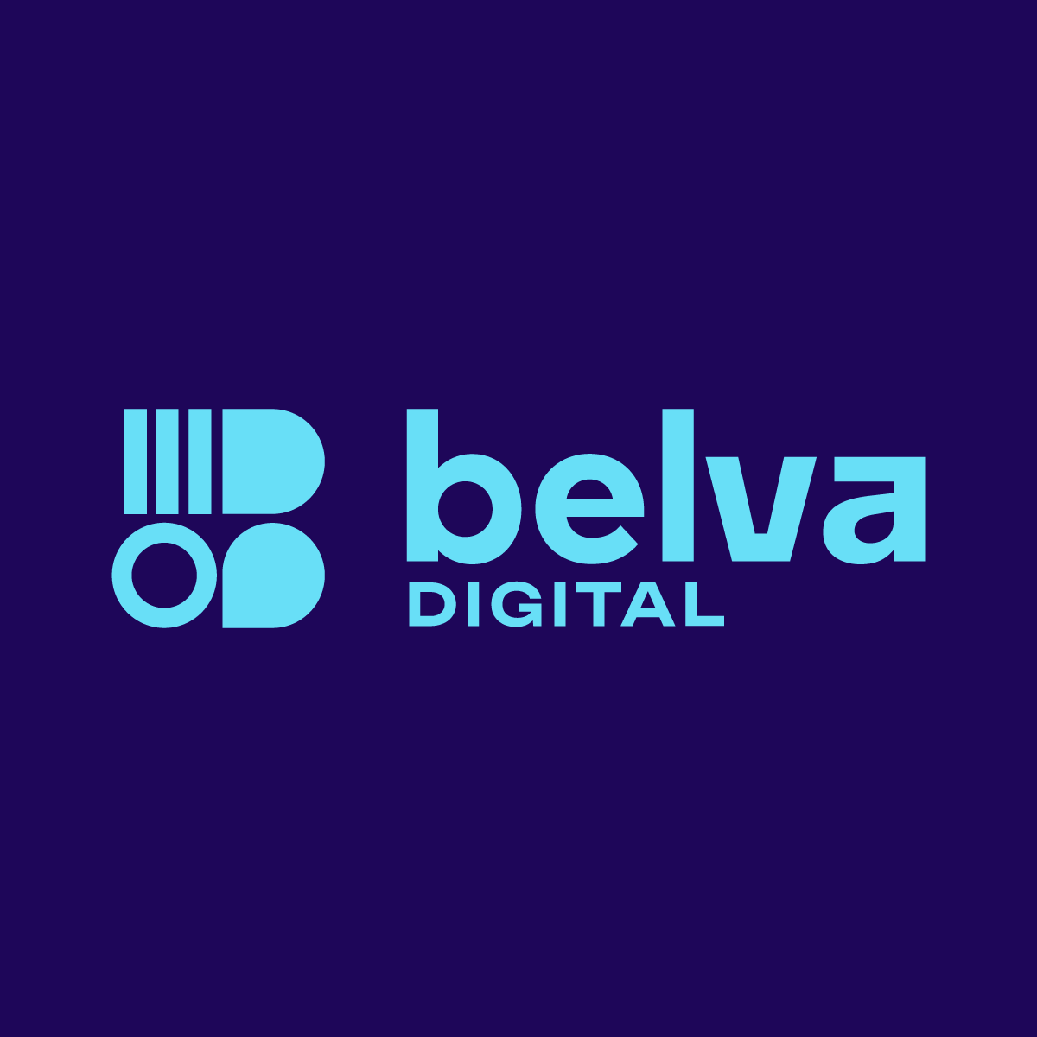
We are an award-winning marketing & technology services agency helping brands connect with consumers while developing new growth & tech ventures.

