Slide 1
Media Scene PROSPECTS - 2024
Prepared for ISA – FEB 2024
Ipsos KE

Slide 2
Introduction
Contents
What worries the world and Kenya
  Global inflation
  Kenya concerns
Audience habits
  Television
  Radio
  Online
  print
Macros Economics
  Economic factors
  Currency exchange rates
  Shift in advertising strategies
Advertising performance trends
  Traditional and
  Digital

Slide 3
Man’s worries and concerns
1
Global trends
What worries the World? Kenyans?

Slide 4





WORLD WORRIES: Long-term trend
Q
Which three of the following topics do you find the most worrying in your country?
Global country average
37%
30%
30%
27%
26%
4%
Inflation | Crime & violence | Poverty & social inequality | Unemployment | Financial/political corruption
Coronavirus
Base: Representative sample of 22,633 adults aged 16-74 in 29 participating countries, 2015 - 2023.
Source: Ipsos Global Advisor. Global score is a Global Country Average. See methodology for details.
Filter: Country: World | Current Wave: Dec 23

Slide 5
Kenyans reaction to inflation: Food and communication are the most significant services (must-haves) during inflation; closely supported by the financial sector
Level of products/services purchase during inflationary times (Aug-2023)
Communication is least affected
Personal care, clothing, restaurants and alcoholic beverages experience significant drops
Budgetary allocation for Pharmaceuticals and health related expenses experienced relative increase
Dealing with High Prices-Which of the following, if any, have you recently purchased (L3M) while shopping? Please select all that apply.? (N=1000 respondents; Aug 2023)

Slide 6
Audience habits
2
Trends and progress
Reach and Time Spent

Slide 7
Quarterly Touchpoints Incidence trended
BY DAY & WEEK; In Q4 2023, online gained hugely while radio shrunk considerably

Slide 8
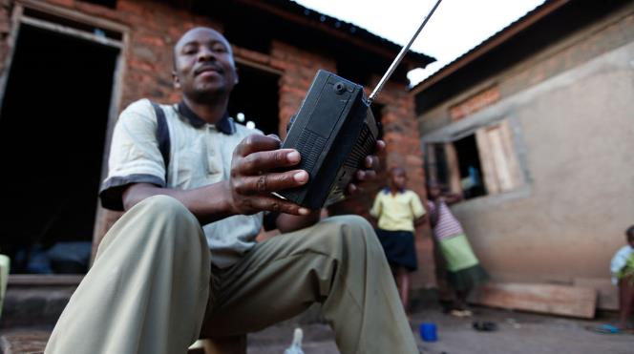
Time spent on platform channel guided by content
Audiences guarding their time tightly
Online usage (mainly cell phone driven) as an on-the-go touchpoint remains in the lead
Radio suffers significant drop on amount of time spent - but this could be a seasonal challenge
Television usage time also slows down but is more consistent and steadier in growth
  3 2/3 hours Internet.
  3 hours radio.
  2 ¾ hours TV.
Ipsos IKAT (Based on users of each medium)

Slide 9
Audience habits
3
Local trends
Touchpoints reach and Time Spent

Slide 10
Expenditure on traditional platforms on a free fall; Radio drops by 36% in three years
Traditional media performance trends: By Total and by Type
Ipsos

Slide 11
Financial sector was the most advertised sector in 2023 (outside media) as Telecoms sector dropped by 59%
Traditional media performance trends: By Category
For the Comms sector, it is unlikely that they will continue shrinking in 2024
Sectors that have had some marked improvement in exposure value in the past 2 years include;-
  Personal care
  Publishing & education
  Retail
  Transport
Ipsos

Slide 12
Digital exposure keeps on exploding. Financial sector performed equally well in the digital space…, as the Telecoms touched the 1bn exposure mark with a 14% share of digital exposure within the period under survey. This is the space to keep watching.
Digital media performance trends: May-Nov 2023
Ipsos

Slide 13
Macro-economics
4
Economy and Media
SSA Scene

Slide 14



Regional Macro Outlook
Currency Crossroads: Unpacking Sub-Sahara Africa's Economic Landscape in 2023
Economic Growth Challenges in Sub-Sahara Africa
Factors such as unstable consumer demand, weak external demand, tight financial conditions, and regional political instability shaped the continent's economic growth.
Select African Exchange Rate Performance vs US Dollar
Inflation Dynamics and Monetary Policy in SSA
  Inflationary pressures decelerated significantly in SSA during 2023, attributed in part to proactive monetary policy tightening.
  Nations that implemented earlier policy rate tightening, like Uganda, saw faster inflation easing compared to those slower in tightening.
Currency Challenges and Exchange Rate Trends
  Most SSA national currencies faced exchange rate losses relative to hard currencies, reflecting the persistent impact of monetary policy tightening and deteriorated macroeconomic indicators.
  The Nigerian Naira experienced the largest depreciation, losing up to 41.0% against the US Dollar, while the Kenyan Shilling depreciated by 21.3%. In contrast, the West African CFA Franc gained an average of 2.5% against the US dollar.
Ipsos
Notes:
-Major currencies across SSA have depreciated significantly against the USD
-There was significant inflationary pressure in 2023 which has led to Central Banks tightening their monetary policies to curb inflation
-Nations that implemented earlier policy rate tightening, like Uganda, saw faster inflation easing compared to those slower in tightening

Slide 15
Regional Macro Outlook
48.8 Kenya PMI December - Inflationary pressures continue to hit demand
Jan-2024 (7.5%)
Forecast - 2024 (6%)
Based on five individual indexes with the following weights: New Orders, Output , Employment, Suppliers’ Delivery Times and Stock of Items Purchased. A reading above 50 indicates an expansion of; <50 represents a contraction
- 21.3%
Ipsos
Jan-2024 (146)
Notes:
GDP growth recovered in 2021 from 2021 from an annual growth rate of -0.3% in 2020 to ~7.6% in 2021.
2023, Kenya’s economy grew by ~5% and is forecasted to grow by ~6% in 2024
Overall inflation was highest in May 2023, this is attributed to a stark increase in fuel prices and a depreciation in the KES. FX depreciation severely impacted the manufacturing sector through a significant increase in cost of inputs for production – during this time the country also faced a Dollar shortage which led to major manufacturers such as Pwani Oil temporarily shutting down operations.
This speaks to the last chart, Stanbic’s Purchasing Managers Index. The index is based on interviews with purchasing managers and tests New Orders, Output , Employment, Suppliers’ Delivery Times and Stock of Items Purchased. A reading above 50 indicates an expansion of; <50 represents a contraction.
Throughout the year, we can see the PMI index trailing below 50, indicating a subdued manufacturing sector during the year. This has impacted the advertising industry through reduced budgets allocated to marketing and more to conserving cashflows.

Slide 16
Economy & Media
SSA predictions
Economic factors
Currency exchange Rates
Shift in advertising strategies
Unstable consumer demand, weak external demand, and tight financial conditions: These factors could lead to:
  Reduced advertising spending: Businesses may cut marketing budgets due to economic uncertainty and lower consumer spending.
  Shift in advertising strategies: Companies may shift towards more cost-effective marketing channels, such as digital advertising, which offers better targeting and cost-efficiency.
  Media sector consolidation: Declining advertising revenue could put pressure on media companies, potentially leading to consolidation or closure of some outlets. An example of this is South Africa's national broadcaster, SABC, which experienced significant revenue decline and job cuts due to the country's 2016 recession.
Most SSA currencies experiencing depreciation: This has both positive and negative consequences:
  Negative impact: Importing equipment and technology becomes more expensive for media companies, impacting their operational costs.
  Positive impact: SSA media and advertising services become more affordable for international clients, potentially increasing export opportunities.
Many SSA companies are increasingly focusing on digital advertising: This trend is driven by digital advertising's cost-effectiveness and ability to target specific audiences compared to traditional media channels, leading to the rise of mobile phone marketing and social media advertising platforms.

Slide 17
Appendix
5
Ipsos Digital Monitoring
We are now monitoring the digital platforms

Slide 18
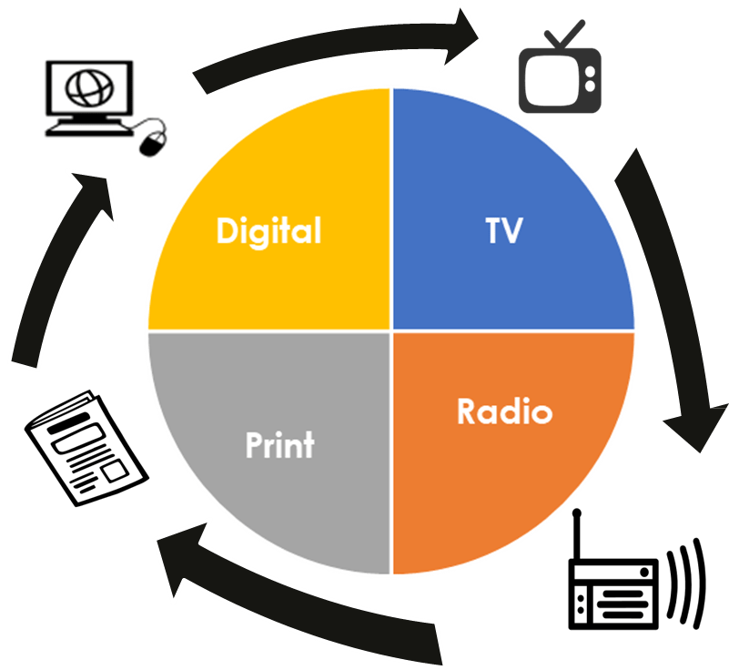




DIGITAL AD MONITORING- THE DIGITAL TREND
“
DIGITAL STATEX
Is a competitive data intelligence tool for online advertising. It provides advertisers valuable information about the performance of their campaigns and understand competitors’ digital strategies and investments against set of important KPIs.
Objective
To ensure multiplatform monitoring to clients.
Experience in East Africa
Deployed tracking solution in Kenya with plans to roll-out to other markets.
Understanding of the Social Media &
Premium Sites
Tracking of social media & premium sites in Kenya market.
Developed Systems
Data collection, data validation, analysis and dynamic dashboard reporting in place.
Key metrics, Ad spends, Ad Impressions: sectors, categories, brands, sub-brands, campaigns.
Monitoring Experience
Over 10 months of daily tracking of the premium websites (over 100+) and social media in Kenya.
10+ months
Data Collection
Data Validation
Dashboard
Reporting
Insight Analysis
The service is accessible on an annual subscription basis via a web-based application: http://online.statexmonitoring.com
<<PLEASE CONTACT US FOR A LIVE DEMO TODAY>>

Slide 19

All information received from the client for the purpose of this research will be treated with utmost confidentiality by Ipsos project team.
Every member of Ipsos involved in this study is committed to this policy and will under no circumstances share any information made available to Ipsos by the client, either in writing or verbally.
Ipsos respects client’s rights and will sign a confidentiality agreement for this project, if need be.
Quality assurance &
data safety

Slide 20




Ipsos
Affiliations & certification
MSRA
ESOMAR
ISO
  Ipsos Kenya is a key members the Market and Social Research Association of Kenya
  MSRA is an industry regulating organization that was forged to drive quality assurance.
  The world association for market, social and opinion research, unites a global membership of 4900 members from 130 countries.
  The ESOMAR Membership mark signals an endorsement of ethical standards and provides a valued means of recognition within the wider marketing and research industries.
Our methods & practices are as per ISO. We are in compliance with ISO 20252:2019

Slide 21

ABOUT IPSOS
GAME CHANGERS
Ipsos is the third largest market research company in the world, present in 90 markets and employing more than 18,000 people.
Our research professionals, analysts and scientists have built unique multi-specialist capabilities that provide powerful insights into the actions, opinions and motivations of citizens, consumers, patients, customers or employees. Our 75 business solutions are based on primary data coming from our surveys, social media monitoring, and qualitative or observational techniques.
“Game Changers” – our tagline – summarises our ambition to help our 5,000 clients to navigate more easily our deeply changing world.
Founded in France in 1975, Ipsos is listed on the Euronext Paris since July 1st, 1999. The company is part of the SBF 120 and the Mid-60 index and is eligible for the Deferred Settlement Service (SRD).
ISIN code FR0000073298, Reuters ISOS.PA, Bloomberg IPS:FP
www.ipsos.com
In our world of rapid change, the need for reliable information
to make confident decisions has never been greater.
At Ipsos we believe our clients need more than a data supplier, they need a partner who can produce accurate and relevant information and turn it into actionable truth.
This is why our passionately curious experts not only provide the most precise measurement, but shape it to provide True Understanding of Society, Markets and People.
To do this we use the best of science, technology
and know-how and apply the principles of security, simplicity, speed and substance to everything we do.
So that our clients can act faster, smarter and bolder.
Ultimately, success comes down to a simple truth:
You act better when you are sure.
Ipsos complies to ISO 20252 :2019 when executing a research project. Ipsos was certified by SGS United Kingdom Ltd, list of certified characteristics available upon request or on www.sgs.com/standard.

