Slide 1

Kenya Digital Landscape
Deconstructing 2023 /2024 Digital Data , Trends and What it Means for you in 2024
February, 2024

Slide 2
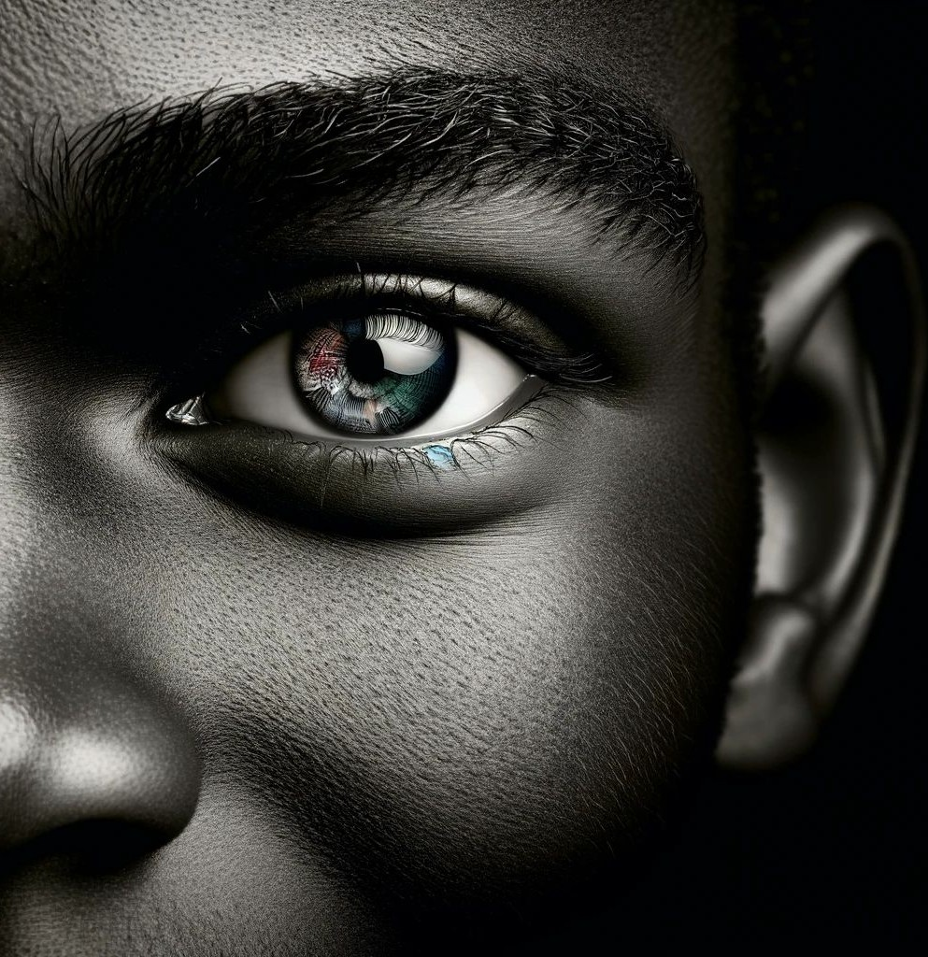
Introduction
shari●ng
Population Vs Active Social Ids Growth
Devices Internet Access
Accessing online information for brand & product discovery
Social media usage
Advertising overview
Emerging Technologies
Table of Contents

Slide 3



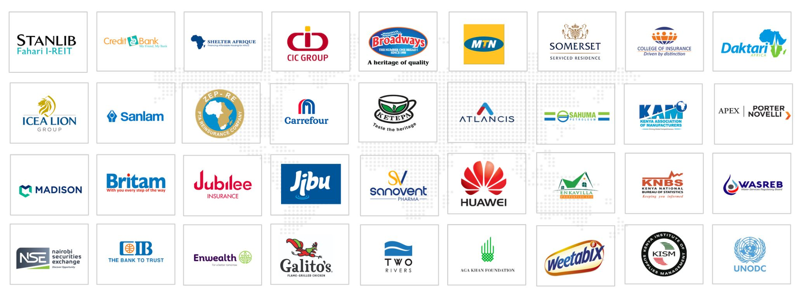
Our Services
About Us
We drive business results using expert digital & advertising services
and repeatable methodology to power your brand.
The Digital Monkeys is an insight driven brand & communications agency that provides strategic, creative and digital solutions for forward thinking companies so that they can realise their brand potential and gain measurable results.
Creative / Advertising
Digital Marketing
Digital, Brand & Creative Strategy
Production: Audio, Visual and Branding/Merchandising
Website & Systems development
We deliver compelling data-led solutions with creativity and efficiency to inform business decisions. We are the credible and reliable alternative.
Our Current & Past
Vision
Our values
To be the most credible and reliable forward thinking digital & advertising agency in Africa.
Authenticity Innovation Courage Excellence Empowerment
Mission
To be unrivalled in crafting compelling solutions through insight, technology and creative thinking

Slide 4

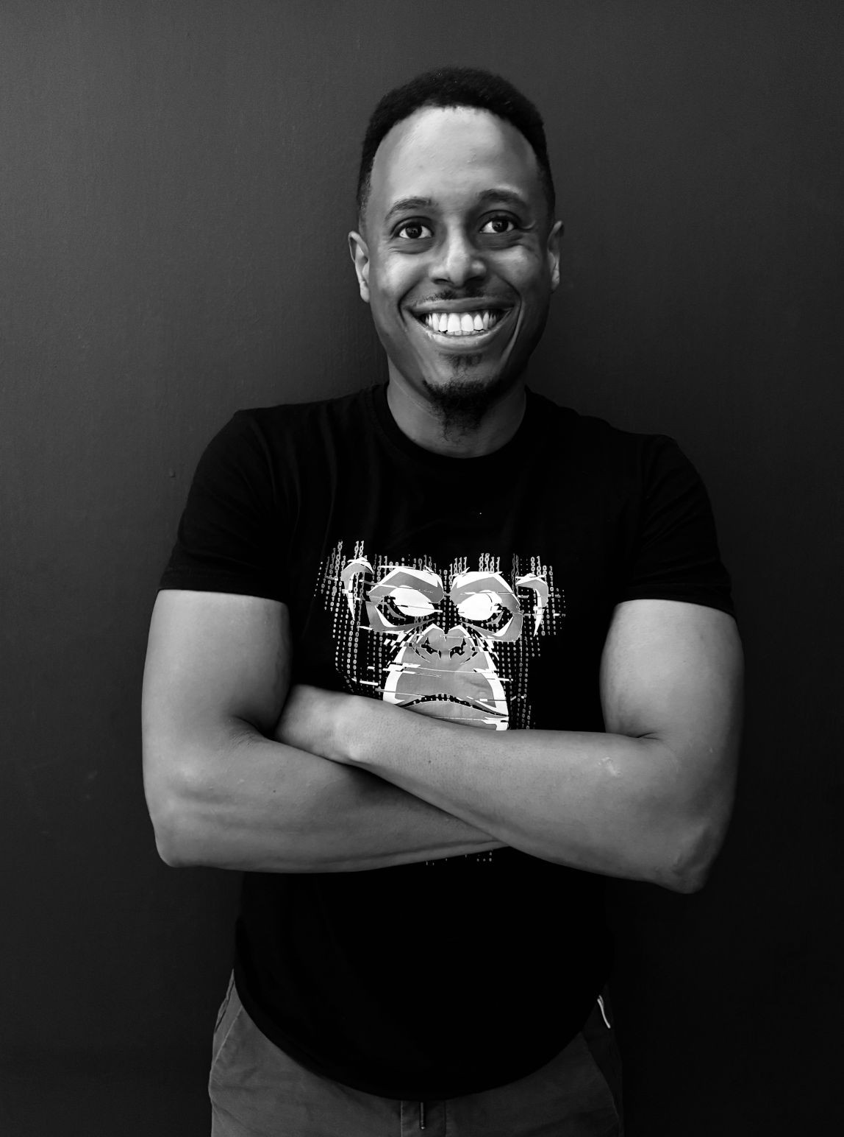

Franc Kabu
Digital & Technology Director, The Digital Monkeys
Franc Kabu is a digital marketing and media professional with over 13 years experience. His experience spans across data analysis, strategic media planning, project management, website development and digital campaign activation.
His expertise is on both b2b and b2c projects across various industry verticals such as retail, technology, financial services, real estate etc. He has a strong knowledge of all main digital channels ranging from paid and organic search, display advertising, social, web analytics and lead generation.
Franc is enthusiastic, outgoing and self-motivated commercial marketeer, with a truly omnichannel approach, communicates well at all levels, able to form good working relationships and has a keen passion for developing and coaching teams.
Brands : Britam, Sanlam, Credit Bank, Mayfair CIB Bank, MTN, SPARC, Galito’s, Shelter Afrique, Two Rivers, The Ascott Limited.
Franc has a Bachelor's Degree in Computer Science from Catholic University and is CIM Certified in Digital Marketing .
franc@tdm.co.ke

Slide 5
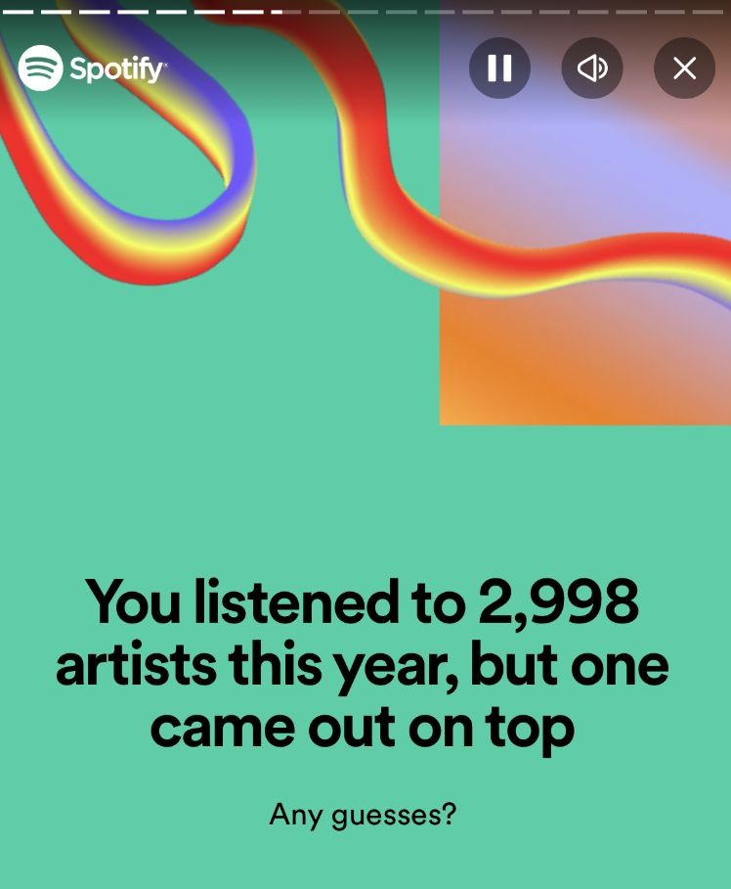
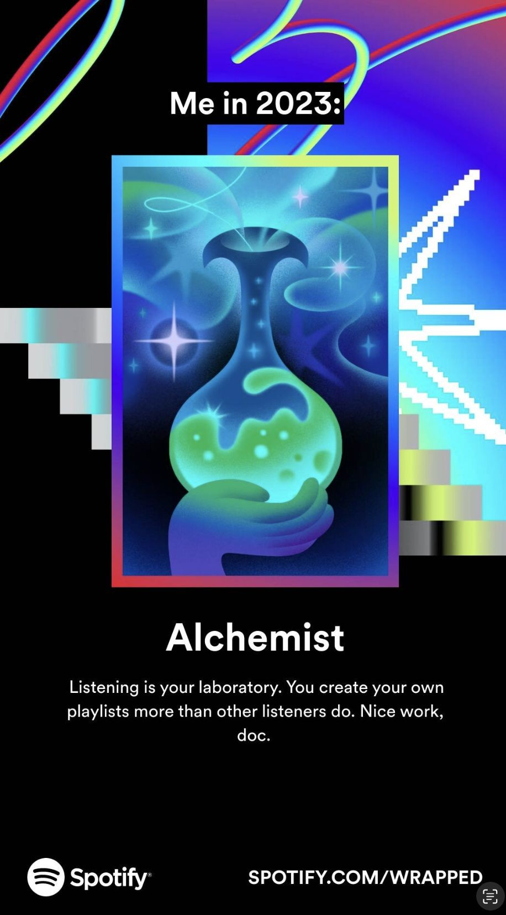
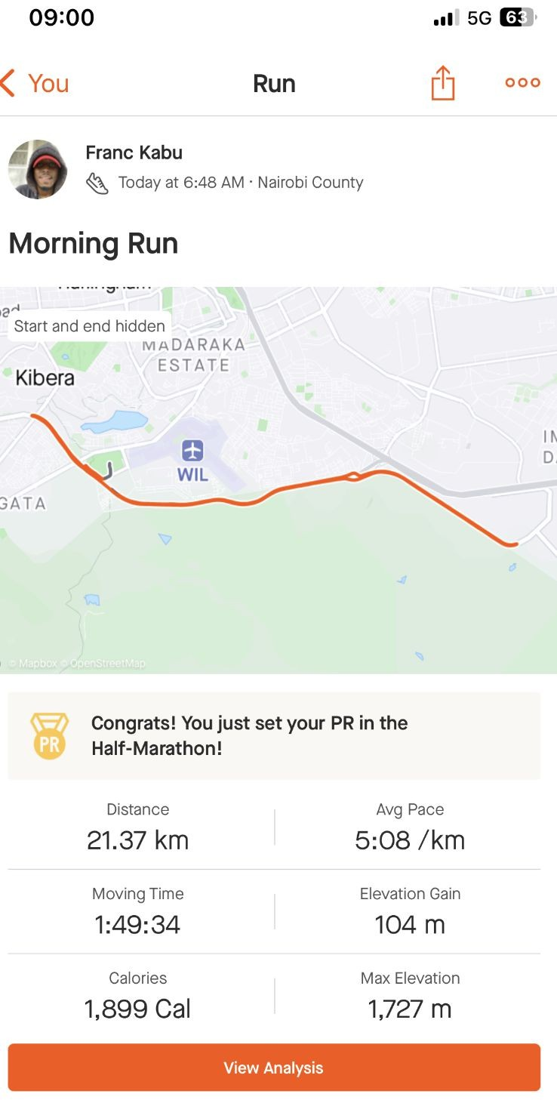
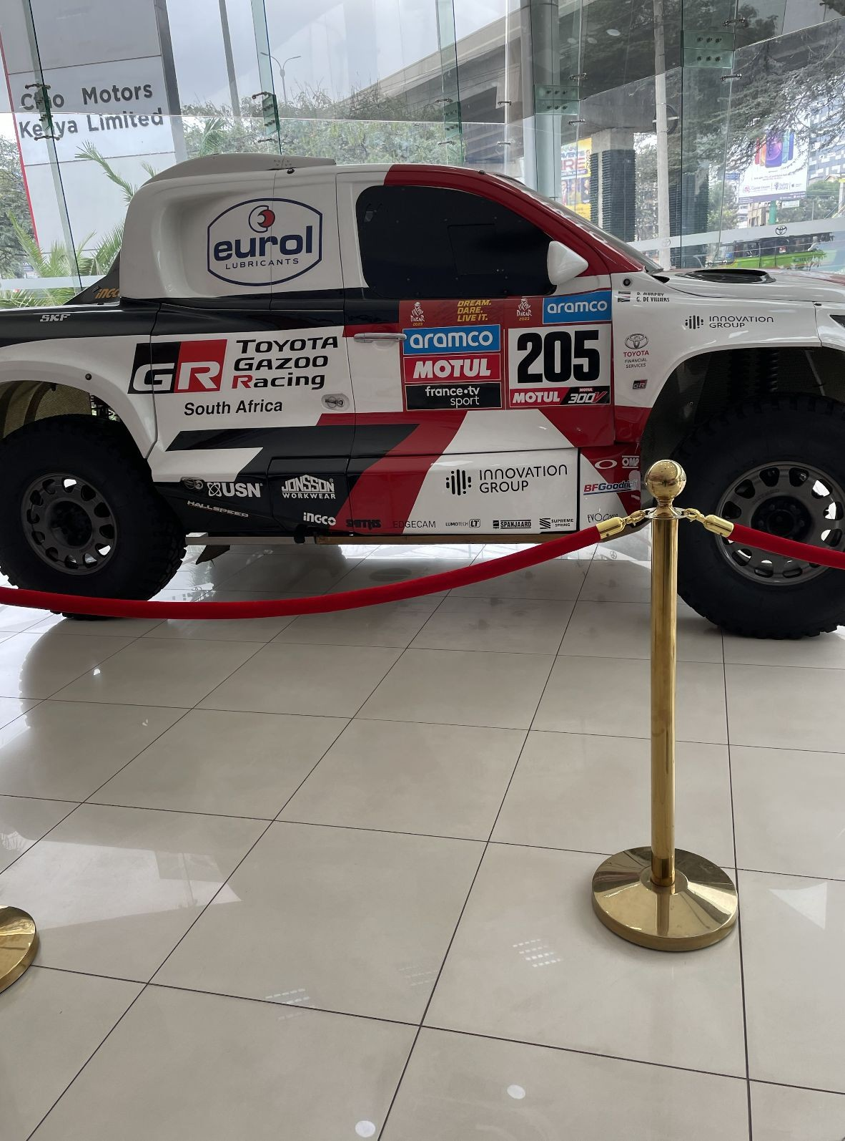

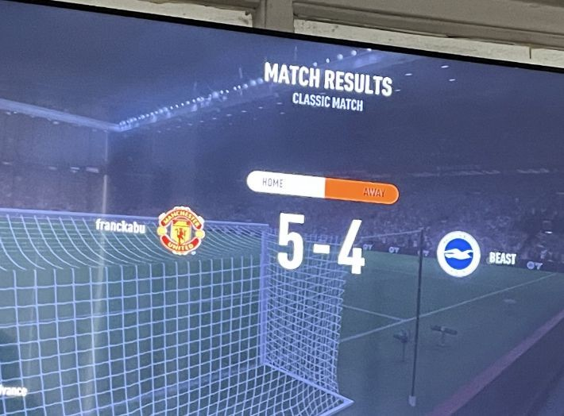

Slide 6













Prepared by The Digital Monkeys
Digital Landscape Kenya 2023 VS 2024
Population 29% is based in Urban centres 70% is based on rural areas.
Internet users )
22.71
Million
Active social media ids are from 18+.
Total population
Internet users )
Total population
55.65
Million
54.56
Million
22.30
Million
29.6% are between ages 18-34.
2023
2024
18.8% are between ages 34-54.
7.2% are between ages 54+.
Female Population
Male Population
49.6%
Male Social IDS
Female Population
Male Population
49.6%
Male Social IDS
Active social media ids
10.55
Million
50.4%
Female Social IDS
Active social media ids
50.4%
Female Social IDS
13.05 43.2%
Million
44.3%
55.7%
56.8%

Slide 7





Devices Internet Access 2023 VS 2024
Prepared by The Digital Monkeys
Mobile still king.
CTV picking over tablet devices.
Mobile 74.90% ( 2023) &
77.65% ( 2024) contributes highly to web traffic.
Mobile phone
Laptop / desktop
Mobile phone
Laptop / desktop
96.8%
31.26%
99.6%
30.96%
Desktop 24.30% ( 2023) &
21.64% ( 2024) contributes highly to web traffic.
Dominant browsers are Chrome (Over 50%) & Opera (Over 30%).
2023
2024
Connected TV
Tablet device
Connected TV
Tablet device
18.0%
8.5%
17.4%
7.1%

Slide 8




Websites & Apps Visited 2024
Prepared by The Digital Monkeys
Top Websites 2023 Visits | Top Websites 2024 Visits
Google.com : 253M TV : 29.9M UV: | Google.com 169M TV : 14.7M UV:
Youtube.com : 183M TV : 29.9M UV: | Youtube.com 80.4M TV : 8.39M UV:
Facebook.com 25.7M TV : 7.05M UV: | Facebook.com 21.1M TV : 4.08M UV:
 | OpenAI.com 11M : 2.43M UV:
Twitter.com 29.8M TV : 7.28M UV: | Twitter.com 8.59.8M TV : 1.71M UV:
Instagram.com 8.65M TV : 3.42M UV: | Instagram.com 6.85M TV : 1.71M UV:
 | Ecitizen.go.ke 4.70M : 1.37M UV:
 | Netﬂix.com 11M :4.07M : 880K UV:
Chat & Messaging & Social Networks
Search Engines & Web Portals
Music & Entertainment
95.95
63.90%
49.65%
2024
Maps & Location Based Services & Mobility Ride
Shopping & Classiffieds
Education
37.4%
31.8%
44.1%

Slide 9





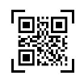

Accessing Online Information 2023 VS 2024
Prepared by The Digital Monkeys
Leverage search in all mediums
Optimize for Visual Search using high-quality, relevant images, and optimizing alt tags and image file names with keywords.
Social Networks
Image Recognition
Search Engines
Social Networks
Optimize for connected media by integrating social signals and content into the SEO strategy is important. This can involve sharing content on social platforms to drive traffic back to the website.
71.8%
24.5%
86.5%
72.20%
2023
2024
Consider translation API’s for bi-lingual assets.
For Voice Search opportunity using natural language and question-based keywords in content is key.
Online Translator Tools
Voice Assistants
QR CODES
Online Translator Tools
21.6%
13.6%
30.7%
22.7%

Slide 10






Social Media Brand & Product Research Information 2023 & 2024
Prepared by The Digital Monkeys
Being relevant to the opportunity.
Brands can establish thought leadership by actively participating in Q&A sites, answering industry-related questions, and providing value.
Social Networks
Question & Answer Sites ( Quora)
Messaging & Livechat
Micro Blogs (X / Twitter)
71.8%
19.3%
18.9%
18.0%
Utilization of messaging and live chat is key having responsive chat support, possibly enhanced with chatbots for 24/7 service.
2023 & 2024
Brands (FMCG) with visually appealing products should leverage online pinboards by creating inspirational and aspirational content that encourages users to research and purchase.
Online PinBoards
VLOGS
Forums & Message Boards
16.9%
13.9%
12.1%

Slide 11








Web Traﬃc Referrals 2023 VS 2024
Prepared by The Digital Monkeys
Balance content with a platform-agnostic approach
Youtube & Instagram doubling web traffic signifies that brands should invest more in video content as it is a highly engaging medium.
Facebook
X
Facebook
X
49.81%
20.18%
28.8%
18.5%
Optimize for X and diversify from Facebook.
2023
2024
Youtube
Instagram
Youtube
Instagram
14.07%
6.17%
27.30%
12.2%

Slide 12


















Prepared by The Digital Monkeys
Most Used Social Media Platforms 2023 VS 2024
Balance content with a platform-agnostic approach
WhatAspp being the most popular can be leveraged for direct communication with customers.
WhatsApp
Facebook
Instagram
WhatsAPp
TikTok
Facebook
89.0%
81.0%
70.2%
86.8%
70.2%
68.5%
TikTok for viral challenges to engage the community.
Despite the decline, for FB & IG brands can maintain a strong presence by utilizing FB's targeting capabilities for ads and Instagram's visual platform for brand storytelling.
2023
2024
TikTok
X/ Twitter
Telegram
Instagram
X / Twitter
Telegram
67.9%
57.5%
51.2%
67.8%
56.9%
43.8%
X is for for real-time engagement, customer service, and to participate in relevant conversations.
Snapchat
Linkedin
Pinterest
Snapchat
Pinterest
LinkedIn
39.2%
34.7%
32.2%
32.6%
32.1%
32.0%

Slide 13







Prepared by The Digital Monkeys
Most Favourite Social Media Platforms 2023 VS 2024
Balance content with a platform-agnostic approach
WhatAspp being the most popular can be leveraged for direct communication with customers.
WhatsApp
Facebook
TikTok
Facebook
TikTok
Instagram
34.1%
17.5%
17.5%
36.1%
20.0%
15.3%
TikTok for viral challenges to engage the community.
Despite the decline, for FB & IG brands can maintain a strong presence by utilizing FB's targeting capabilities for ads and Instagram's visual platform for brand storytelling.
2023
2024
Instagram
X/ Twitter
Telegram
Facebook
X / Twitter
Pinterest
12.6%
8.5%
2.3%
10.3%
7.8%
3.2%
X is for for real-time engagement, customer service, and to participate in relevant conversations.
Snapchat
Linkedin
Pinterest
Telegram
LinkedIn
Snapchat
1.3%
1.3%
2.3%
2.4%
1.1%
0.7%

Slide 14





Social Media Advertising Audience Overview 2024
Prepared by The Digital Monkeys
Being relevant to the opportunity.
Tailor ad based on objective as well as tailor content to platform
Diversify Ad Spend with estimated ROI based on ad objective.
Potential Ad Audience
Potential Ad Audience
Potential Ad Audience
Potential Ad Audience
15.25M
9.79M
3.05M
3.16M
2024
Potential Ad Audience
Potential Ad Audience
Potential Ad Audience
4.30M
1.87M
10.60M

Slide 15








Digital Advertising Spend Overview 2024
Prepared by The Digital Monkeys
Total
Programmatic Ads
Search Ads
Banner Ads
Video Ads (+16.1%)
29.74M$
Classiffieds (+2.0%)
11.72M$
108.4M$
75.00M$
17.28M$
26.77M$
2024
Video Content is King
Banner Ads are still strong
Search is Fundamental
Inﬂuencers hold Value
Social Media's play a dominant role
Emerging opportunities in digital audio
Social media digital ad spend
Digital Audio Ads
Inﬂuencer ad spend
1.63M$
1.85M$
29.90M$

Slide 16

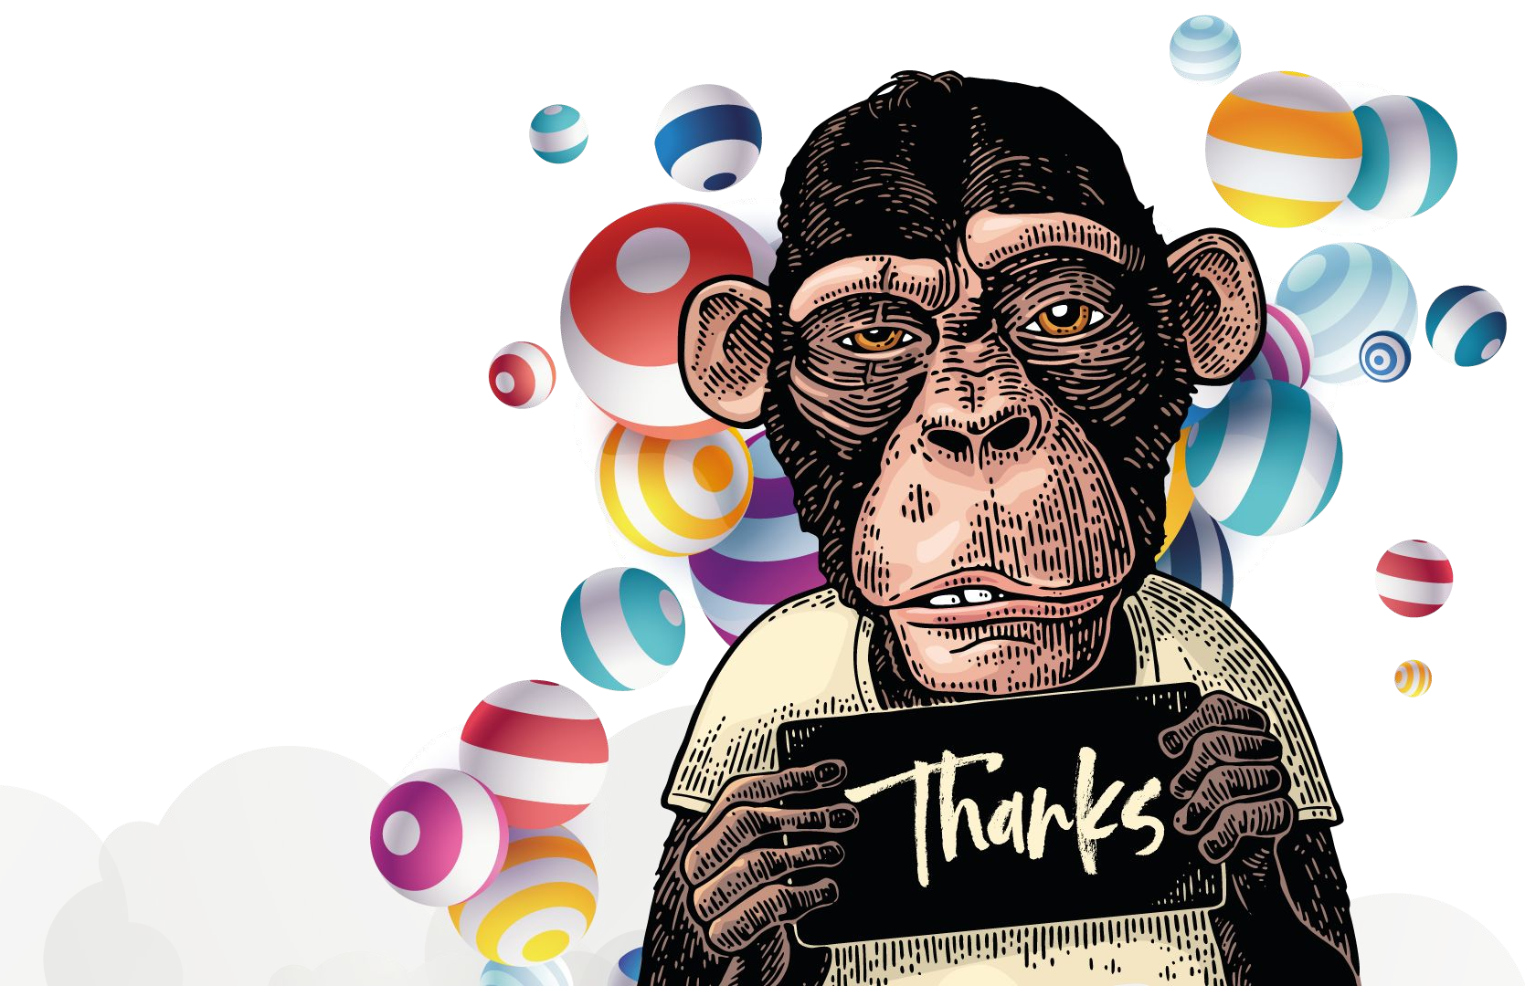

Head Offfice
14, Pergola Flats Milimani
P. O. Box, 59925 - 00200, Nairobi, Kenya.
Phone
(+254) 0100 12 58 58
(0) 715 958 708 • (0)786 193 395
(0) 722 313 800 • (0) 715 886 077
dm@tdm.co.ke www.tdm.co.ke

