Slide 1
2023 MARKET
INSIGHTS & TRENDS

Slide 2

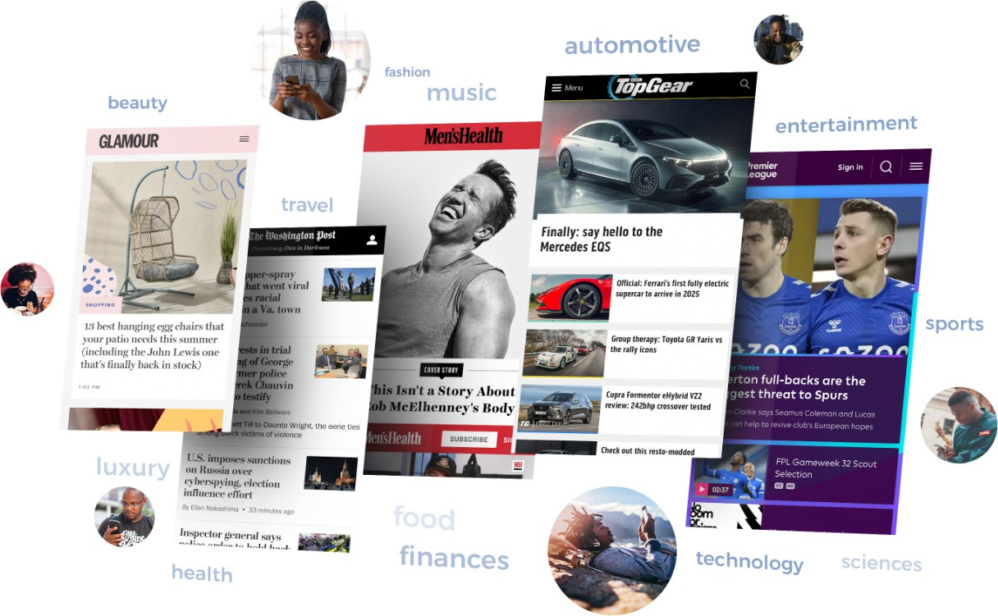
FY 2023
7.75B
29.2M
Device Mobile Desktop Others
Format Display only | 69%
Video only | 14%
Display & Video | 13%
Audio & Video | 5%
Audio Only | <1%
Unknown | <1%
94%
5%
<1%
HY 2023
6.79B
Device Mobile Desktop Others
20.8M
Format
Display only | 76%
Video only | 13%
Display & Video | 6%
Audio & Video | 5%
Audio Only | <1%
Unknown | <1%
94%
5%
<1%
01

Slide 3





FY 2023
Male | 57%
Female | 32%
Unknown | 11%
HY 2023
Male | 47%
Female | 42%
Unknown | 11%
25-34
35-44
18-24
45-54
55-64
65+
Unknown
34%
20%
19%
10%
5%
2%
10%
35-44 | 30%
25-35 | 26%
18-24 | 19%
55-64 | 8%
45-54 | 5%
65+ | 2%
Unknown | 10%
who can actually see your ads
02

Slide 4

Yes, Google started removing third-party cookies in 2024, initially disabling them for 1% of Chrome users globally in a phased approach. This effort aims to boost user privacy by reducing third-party tracking. Google intends to expand this change, targeting a full phase-out for all Chrome users by mid-2024. With Chrome's majority market share, this equates to affecting 30 million users currently.
Top data strategies after cookie shutdown;
Contextual targeting
Publisher ID
Universal ID
Google Topics
First party data
03

Slide 5
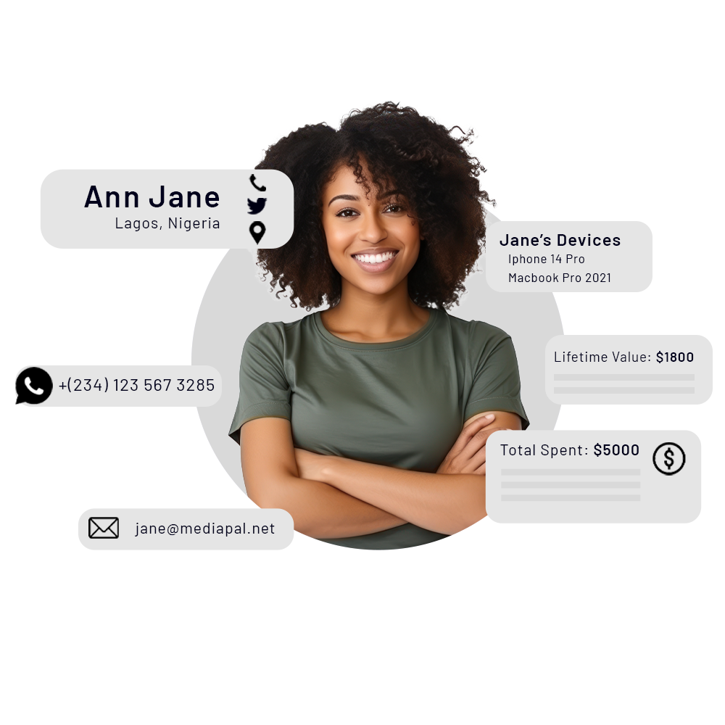
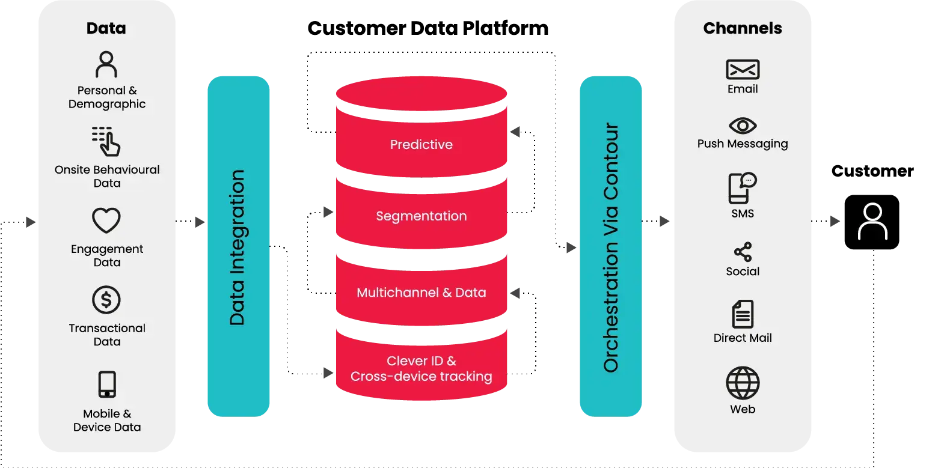

A CDP consolidates customer data from multiple sources into a single profile so that you can know each individual like they are your only customer. This enables precise audience segmentation and targeted marketing by aggregating interactions and transaction data.
Data Collection, Profile Unification, Audience Segmentation, and Activation to derive a 360-degree view of your customer.
Data Unification
Data Activation
04

Slide 6


A Decision-Making Model that combines the power Of AI and Human Judgement
Other Info (Non-digital)
Machines
Big data
AI
Possible Actions
Human Judgement
Business Decisions
05

Slide 7
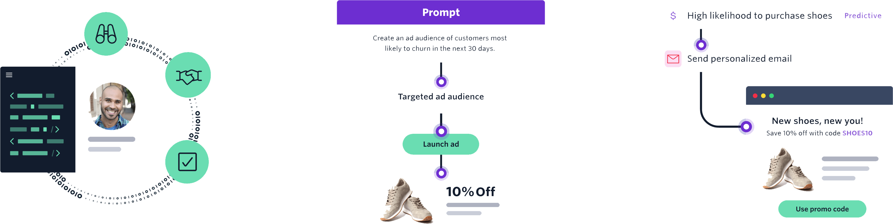
AI Ready Data
The quality of your AI results depends on the input data. Begin with clean, well-managed data and robust privacy controls to ensure precise recommendations and predictions.
Generative AI
Build customized audience segments and launch personalized customer journeys using simple text prompts.
Predictive AI
Predict customer behavior to build targeted audiences and more personalized campaigns that lower costs and increase conversions.
06

Slide 8

Real-Time Bidding (RTB): AI enhances programmatic advertising through real-time bidding, where ad inventory is bought and sold on a per-impression basis in milliseconds. AI algorithms analyze data to make instant decisions on which ads to buy, optimizing ad placement for better performance.
Targeted Advertising & Personalisation: AI algorithms analyse consumer data to identify patterns, preferences, behaviours and platforms. This enables advertisers to create highly targeted ad campaigns that reach specific demographics, increasing the relevance of ads and improving engagement rates.
Optimization of Ad Spend: AI tools can predict the performance of different advertising strategies, allowing for the optimization of ad spend. By allocating budget to the most effective channels and campaigns, businesses can maximize their return on investment.
Customer Insights and Segmentation: AI helps in deep diving into customer data to unearth insights and segment audiences more effectively. This segmentation allows for more precisely targeted marketing campaigns.
Predictive Analytics: AI can forecast future consumer behaviour based on historical data, helping advertisers to anticipate market trends and adapt their strategies accordingly.
07

Slide 9

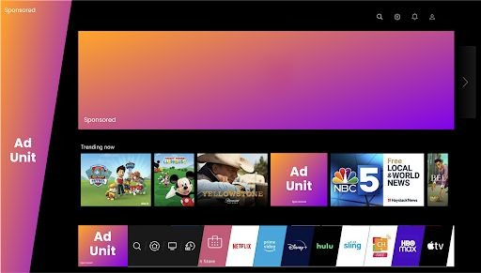
Campaign objective and performance doesn’t rely on one digital platform or channel or strategy. Our platform is built to have a data informed view of the entire advertising ecosystem.
Ad Unit
Main Channels;
Display
Video
Native
Mobile
CTV
Audio
DOOH
08

Slide 10

7.82M 1M
CTV is gaining traction in Kenya, with over 1 million Connected TV devices. This extensive reach, combined with inventory from leading brands like LG and Hisense, ensures brands can leverage premium placement and visibility in the connected TV ecosystem.
2.91M 48K
Advertisers can target audiences through;
Demographic:
Age
Family Users
Proxy Income
Contextual:
Entertainment
Music/comedy/Sci-FI
Gaming Audience
Heavy Streamers
Nationality:
Kenyan
Indian
Chinese
Language Targeting
Original Equipment Manufacturer (OEM) Reach | 1,0002,568
OEM Monthly Impressions | 7,817,976
Appographic:
App used/Not used
Lapsed App Users
Technology:
IP Targeting
Automatic Content Recognition
Location
TV Device Targeting:
TV size
TV model
TV price
Number of TVs
09

Slide 11
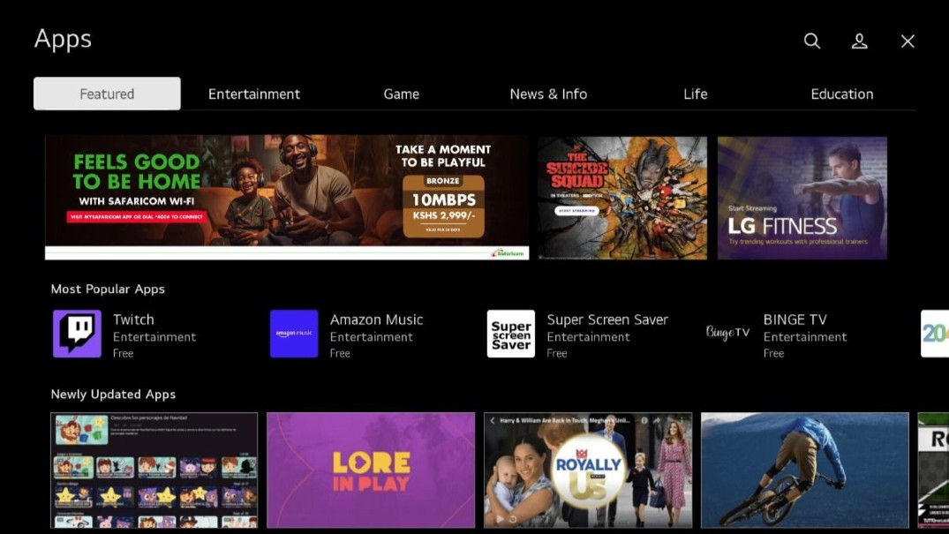
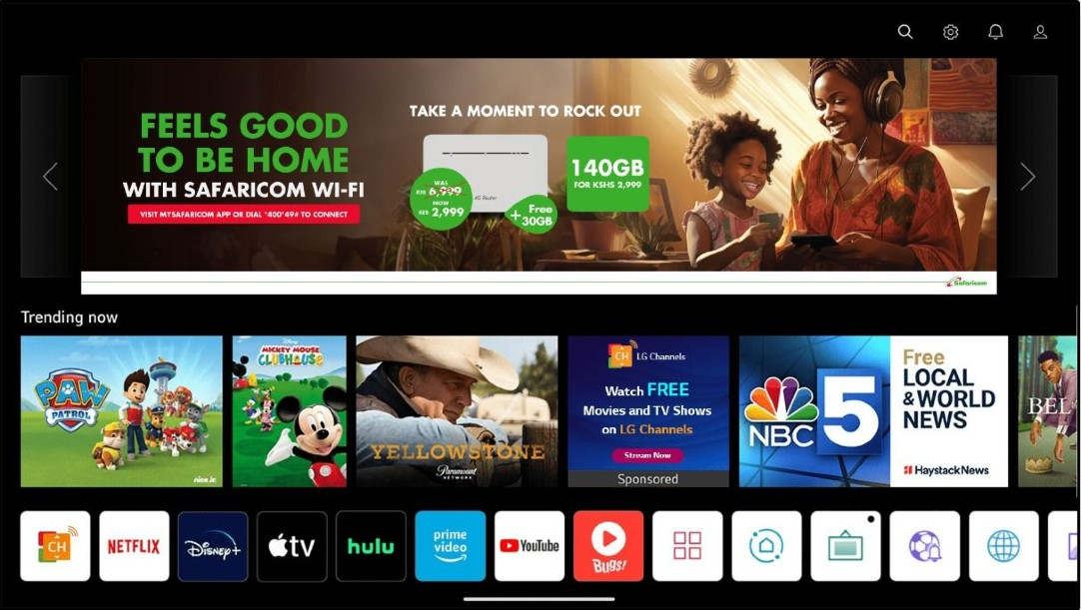
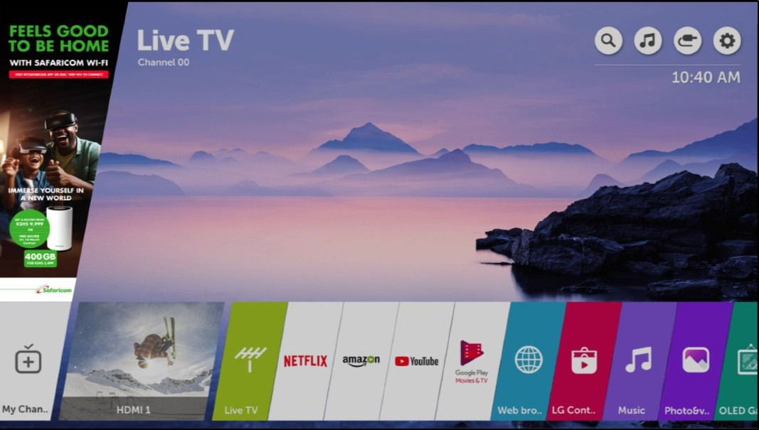
Display Wedge Banner
Prime Display & Video
LG OEM Playstore Display
10

Slide 12












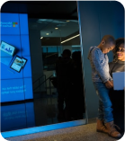


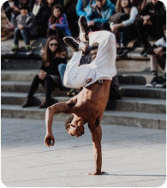













Trending Creative Formats
Growth of Opinion-Driven Creatives To Push Performance
15

Slide 13

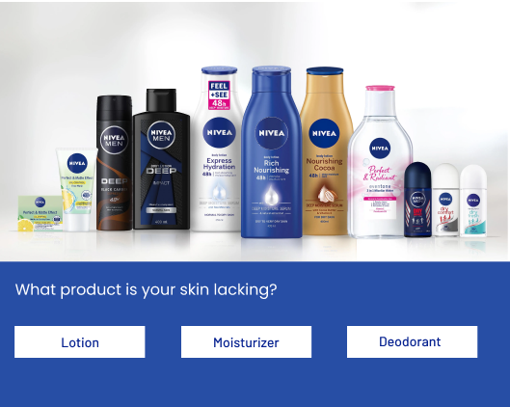
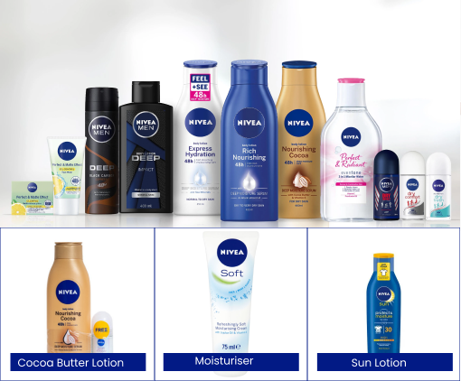
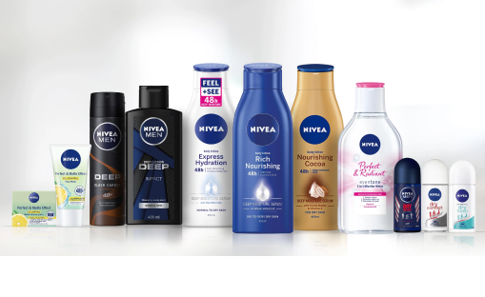

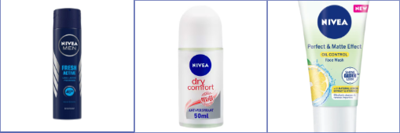
Advertisers can leverage Opinion Ads in e-commerce by creating engaging ads that prompt users to share their opinions or preferences on various products or services.
These interactive ads can gather valuable insights into consumer preferences, behaviours, and trends, which can inform future advertising strategies, ultimately enhancing the overall shopping experience and driving sales.
Fresh Active Deo
Dry Comfort Deo
Face Wash
14

Slide 14

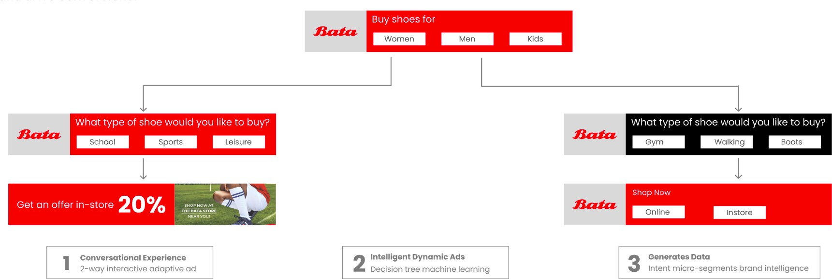
Advertisers can leverage Opinion Ads in intelligent dynamic Ads to not only tailor ad content based on user interests but also generate
valuable data on consumer preferences and behaviours, facilitating informed decision-making and personalized targeting strategies to maximize engagement and drive conversions.

Slide 15
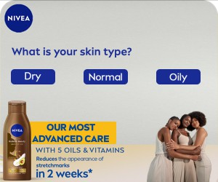
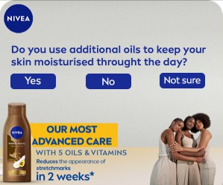
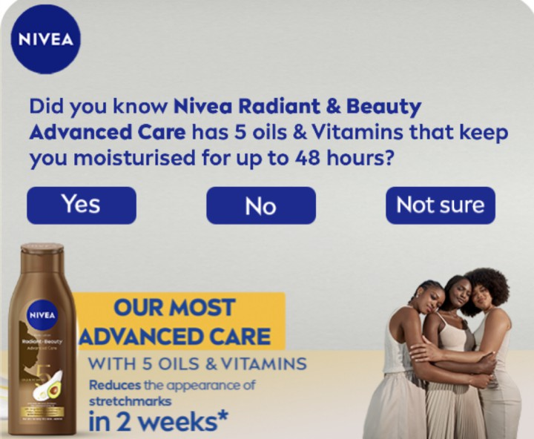


This involves generating data to gather valuable consumer insights through interactive surveys and targeted advertising campaigns.
Interactive display ad
Engage audience within ads. Generate data from display ads.
Increase brand interaction
Generate 1st party intent & brand intelligence data
Multi question survey ads
Responsive ads
Research ads
Story ads

Slide 16








Opinion poll Ads facilitate the creation and deployment of interactive polls within advertising campaigns, enabling businesses to gather valuable audience opinions and insights.
Have you seen any of the following
series ads recently?

Slide 17

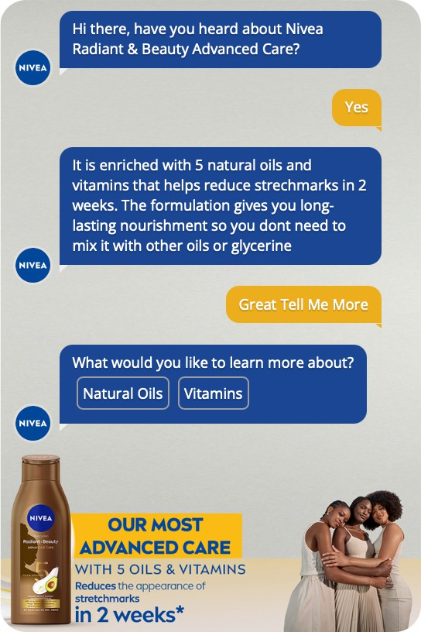
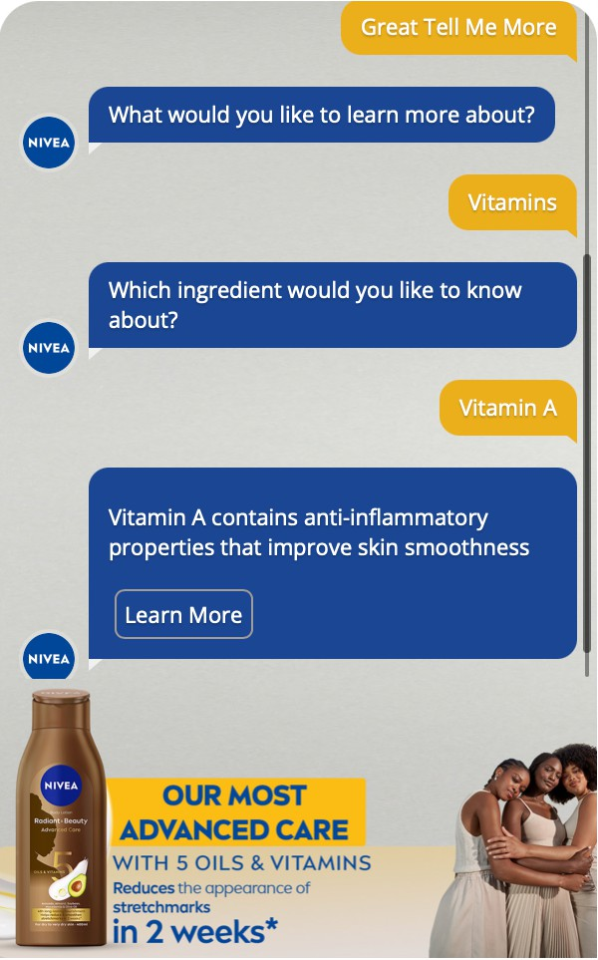
Getting opinion through conversational creatives deliver captive and valuable ad experiences on mobile or desktop.
Let us ask people what they want instead of assuming what they need. Brands have the power to make online advertising conversational.
Welcome to the future of advertising.

Slide 18


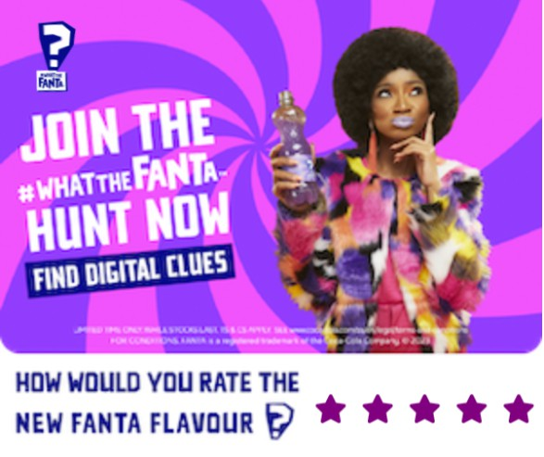
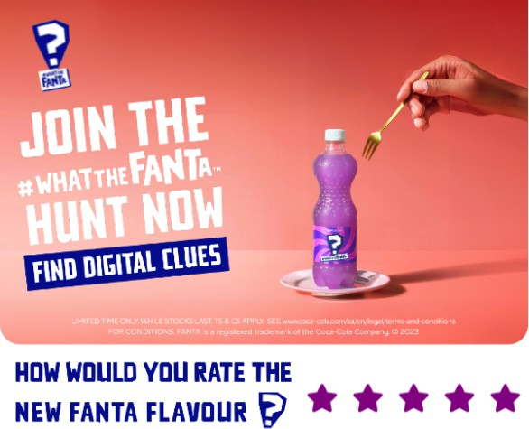
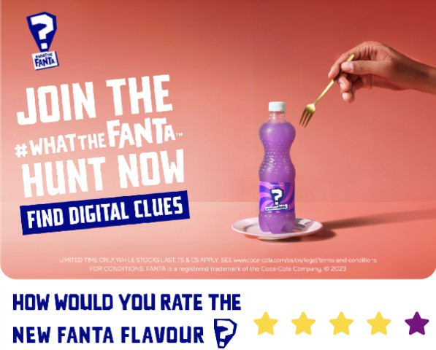

You can leverage Opinion Rating Ads by integrating interactive elements like star ratings, enabling users to share opinions directly within the ad.
Feedback can be aggregated, offering valuable consumer insights to inform future advertising strategies and targeted distribution to maximize engagement.

Slide 19


Thank You
Email: advertisers@mediapal.net
SCAN TO VIEW OUR DECK

